Slide 1
Open Access Dissemination and Publishing – an institutional view
Dr Paul Ayris
Director of UCL Library Services and UCL Copyright Officer
Chief Executive, UCL Press
Adviser to LIBER (Association of European Research Libraries) on EU matters and Horizon 2020
Chair of the LERU community of Chief Information Officers
e-mail: p.ayris@ucl.ac.uk

Slide 2
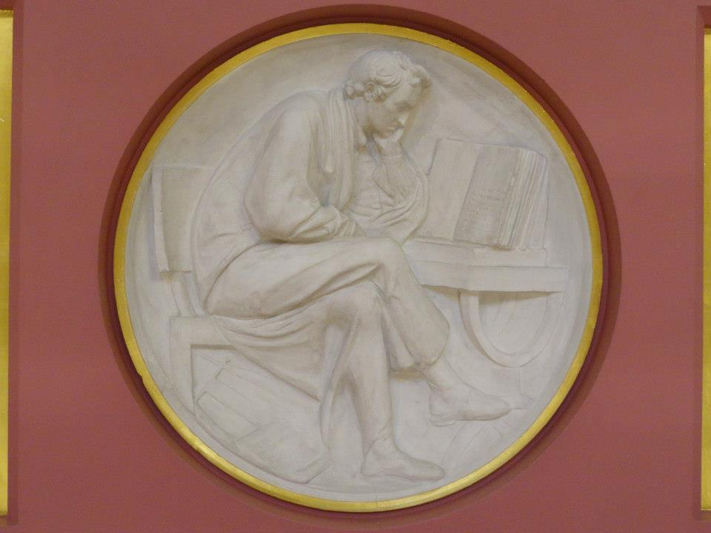
Contents
Strategy
Partnerships
UCL Press
Textbooks
Conclusions?
Plaster Relief by John Flaxman, Flaxman Gallery, UCL

Slide 3
Contents
Strategy
Partnerships
UCL Press
Textbooks
Conclusions?
Plaster Relief by John Flaxman, Flaxman Gallery, UCL

Slide 4
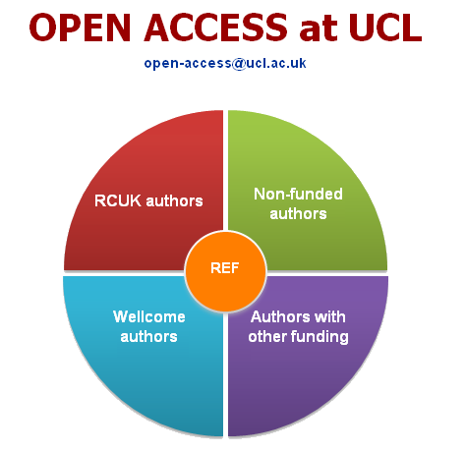
Strategy
UCL OA strategy at http://www.ucl.ac.uk/library/open-access/
Cost of APCs not a barrier to OA publication
Monies from
  UCL Research budget
  RCUK, Wellcome, ERC
UCL has OA mandate at http://www.ucl.ac.uk/library/publications-policy.shtml
REF 2020 OA policy requirements

Slide 5

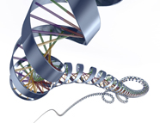
: Open Access growth
To end April 2014
UCL’s OA availability via UCL Discovery: 21,655 outputs.
Figures comprise local Green full text, and records with links to externally-held OA full text

Slide 6
OA coverage, 2011 -
Snapshot at 19 May 2014
Discovery ‘OA in progress’ are pending items, mainly attributable to lead time between APC payment and publication

Slide 7
Downloads
Full-text download counts to 18 May 2014
 | Q1 | Q2 | Q3 | Q4 | Total
2014 | 430,828 | 248,197
2013 | 334,159 | 343,262 | 320,162 | 379,428 | 1,377,011
2012 | 213,402 | 245,836 | 229,864 | 349,688 | 1,038,790
2011 | 146,748 | 155,152 | 107,601 | 175,464 | 584,965
2010 | 117,514 | 133,024 | 128,924 | 146,690 | 526,152
Lifetime downloads (from Feb 08): |  |  |  |  | 4,692,589

Slide 8
All APCs
809
468
668
1945
1945 APCs processed since April 2013
March figures incomplete, pending pre-payment returns from publishers

Slide 9
Contents
Strategy
Partnerships
UCL Press
Textbooks
Conclusions?
Plaster Relief by John Flaxman, Flaxman Gallery, UCL

Slide 10

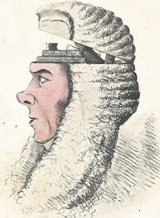
LERU OA Legal Portal
LERU has 21 research intensive universities as members in Europe – see http://www.leru.org
Portal would be built by TEL (The European Library)
All LERU OA legal publications brought together into one interface
Value-Added Services, such as Text and Data Mining, also possible
A Box of Useful Knowledge
(Brougham Papers, UCL Library Services)

Slide 11


Benefits of Partnership working
Portal builds on shared values - collegiality, research and knowledge creation as a shared endeavour, expressed in LERU Roadmap Towards Open Access
Costs shared amongst members
Creation of a value-added product amongst a subject community with strong ties
http://www.leru.org/files/publications/
LERU_AP8_Open_Access.pdf
Gratian, 12th century: Decretum cum summario
Joannis de Deo Hispani.
Nuremberg: Anton Koberger, 28 February 1483

Slide 12
Contents
Strategy
Partnerships
UCL Press
Textbooks
Conclusions?
Plaster Relief by John Flaxman, Flaxman Gallery, UCL

Slide 13
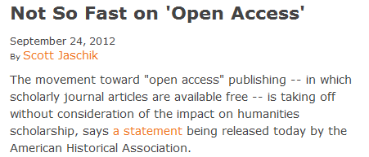
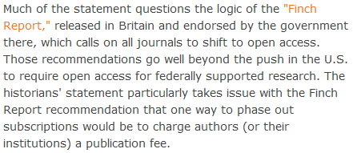
The view from Arts and Humanities?
http://blog.historians.org/2012/09/aha-statement-on-scholarly-journal-publishing /

Slide 14
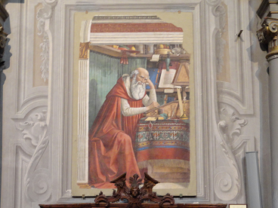
UCL Press
Saint Jerome in his Study, fresco by Domenico Ghirlandaio, 1480. Church of Ognissanti, Florence
Imprint licensed to commercial publisher
Repatriated to UCL on 1 August 2014
Run by UCL Library Services as a department of the Library
Publishes Open Access journals using OJS
OA Research Monographs to be published using Open Monograph Press
OA Textbook platform being created, funded by JISC project

Slide 15
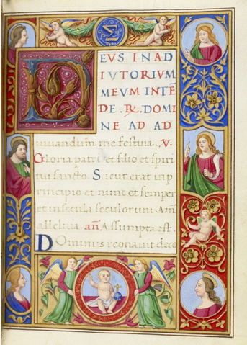
Monograph Publishing
Is Open Access a solution to broken Business Model?
University Press takes on role as monograph publisher
Long form monographs, peer reviewed
Short monographs in AHSS – new publishing format?
UCL Special Collections, 15th century Book of Hours, with 19th century additions. MS. Lat. 25

Slide 16

Shared European infrastructure for monographs?
19 European partners, led by UCL
European universities can become publishers themselves
Shared publishing infrastructure with Open Access business models
Research monographs in the Arts, Humanities and Social Sciences
OAPEN to provide much of the technical infrastructure
To be launched at UCL in December 2013
UCL Special Collections. Pentateuch, 1666.
STRONG ROOM MOCATTA Q B 12 TAR

Slide 17
What could be achieved?
OUTPUTS
Shared publishing infrastructure Shared by 19 partners Scaleable to all European Universities
Advocacy for new solutions to solve monograph crisis
Marketing frameworks
Business Modelling activities
At least 180 OA monographs in 35 series

Slide 18
Indicative series in European collaboration
35 series titles proposed in total | Subject area
Media History and Film Theory | Media studies, Film theory
Spirituality Studies in Theology | Theology
World Oral Literature Series | Literary Studies
Iranian Studies | Middle Eastern Studies
Law, Governance and Development Research | Law, International Studies
Interdisciplinary Issues - Art, City, Society | Urban Studies
New Ideas in Human Interaction | Linguistics

Slide 19
Contents
Strategy
Partnerships
UCL Press
Textbooks
Conclusions?
Plaster Relief by John Flaxman, Flaxman Gallery, UCL

Slide 20
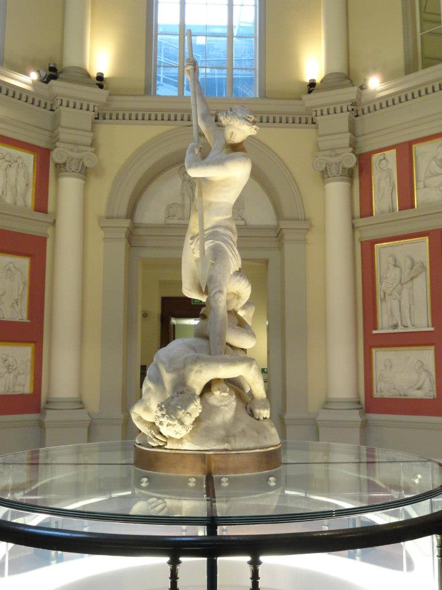
Challenges
Students want remote access to core readings 24x7
In the US, just five textbook publishers control more than 80% of the $8.8 billion textbook market
E-book publishers are nervous about making course texts available as e-books (free at the point of use) as they do not want to cannibalize their print sales to students and lose revenue
St Michael, by John Flaxman, UCL

Slide 21
Opportunities
UCL academics, particularly in Physical Sciences and Engineering, produce their own textbooks
UCL has started its own Press, as a Department of UCL Library Services
Open Access is a core value of the Press
Open Access to educational resources will be part of UCL’s new Education Strategy
UCL Special Collections. Pentateuch, 1666.
STRONG ROOM MOCATTA Q B 12 TAR

Slide 22
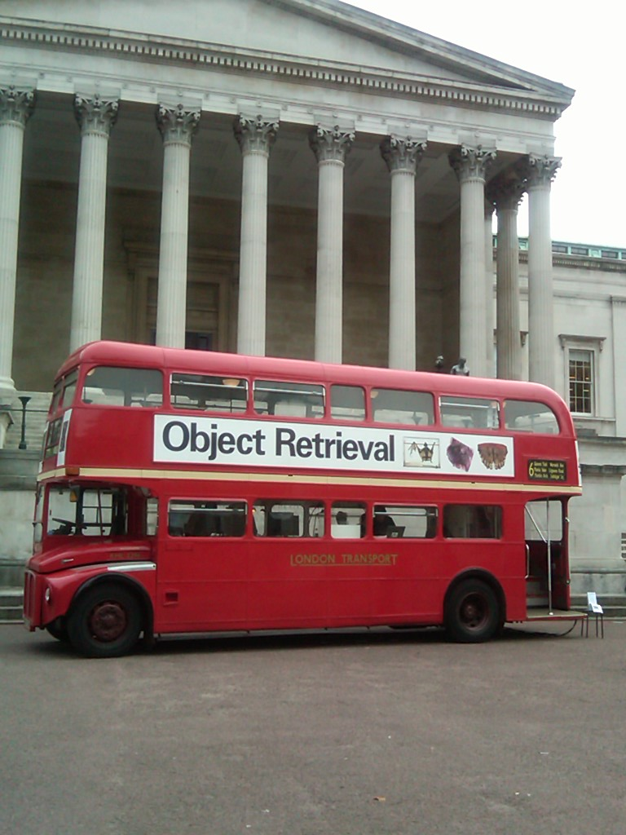
JISC Call - Institution as e-textbook publisher
£75,000 awarded to UCL
To create an Open Access E-Textbook publishing platform
  To complement OJS for journals and OMP for monographs
2 textbooks being delivered as proof of concept
1 in Medical Sciences and 1 in Social Sciences

Slide 23
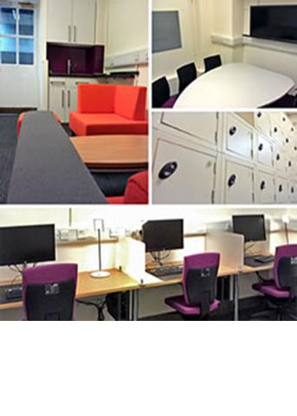
Public Archaeology
Course Book in Public Archaeology
Will give overview based on current undergraduate and postgraduate teaching
Will take account of global scholarship and practice
Target audience is undergraduates and postgraduates
Lecturers in countries where Public Archaeology is a growing field of practice

Slide 24
Plastic and Reconstructive surgery
Written by leading practitioner at Royal Free Hospital
Intended for MSc in Burns, Plastic and Reconstructive Surgery
Will provide overview for students coming from a variety of specialisms across the world
Course is only one of a handful to train medics not only in practice, but also in research and innovation in materials and techniques

Slide 25
Characteristics of E-Text Book platform
Open Access business model
Sales via Print on Demand/enhanced e-models
Books will be peer reviewed before publication
Innovative digital technology
Discoverable in UCL Discovery & Directory of Open Access Books
UCL Special Collections, 15th century Book of Hours, with 19th century additions. MS. Lat. 25

Slide 26
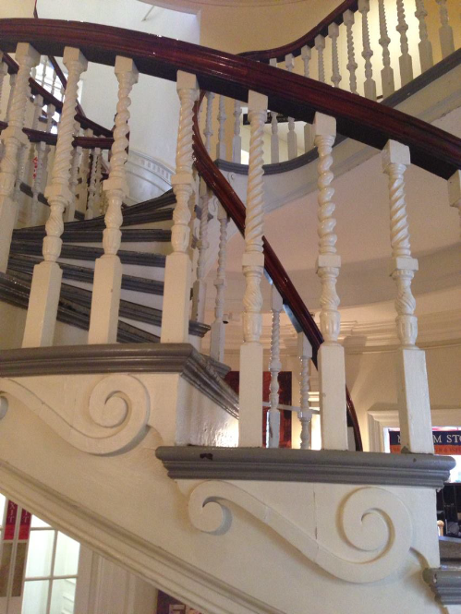
Next Steps for Textbooks
E-Textbook platform will complement existing journals and monograph platforms
Supports UCL’s new Education Strategy and E-learning agenda
Provides a solution to the challenge of digital E-Textbook publishing
Old State House, Boston, USA

Slide 27
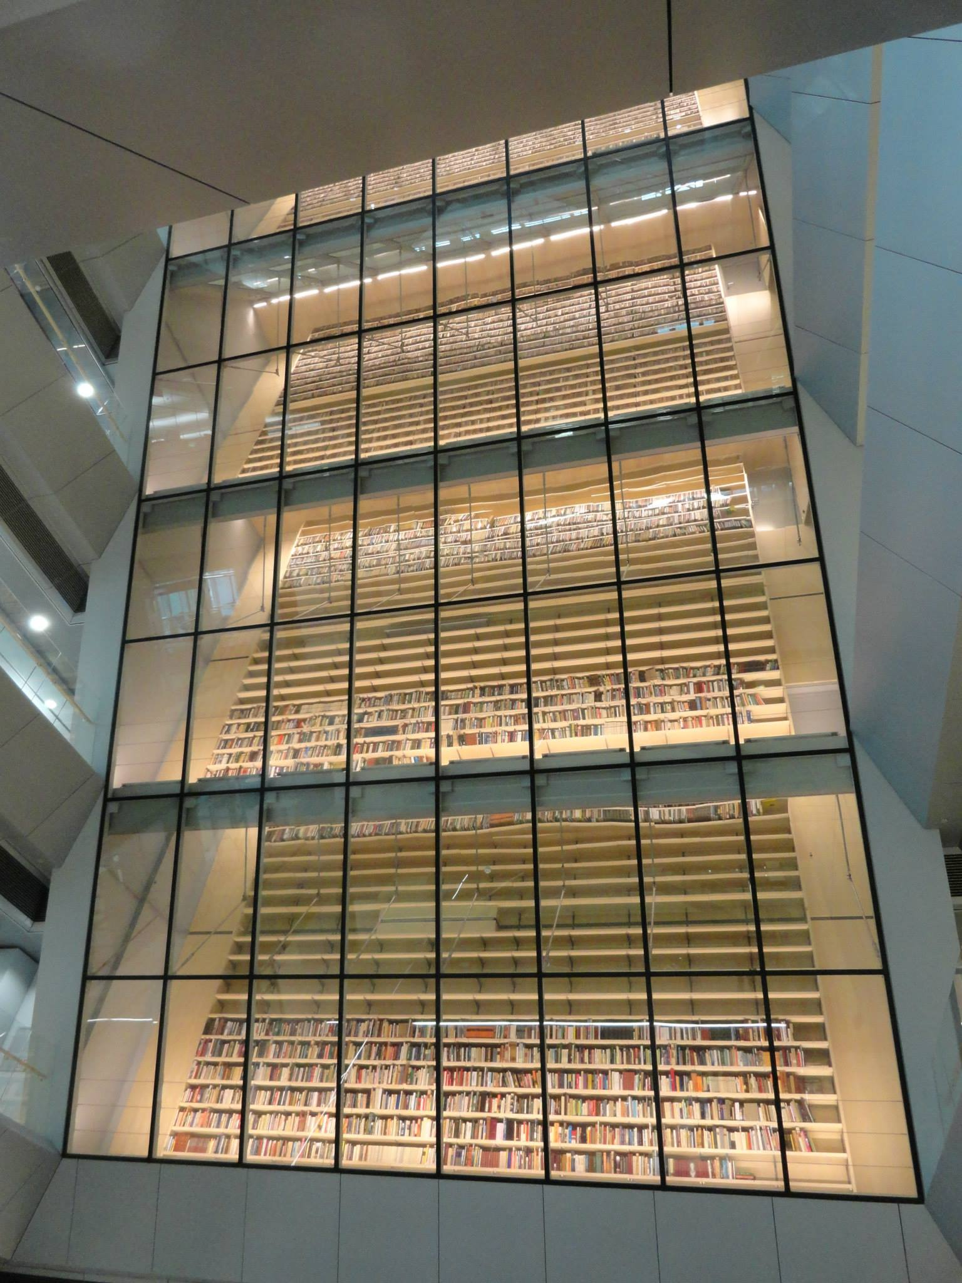
Conclusions
Library
  has a new role in institutional arena
  Supporting Open Access places emphasises role in research support
  As a publisher, Library becomes a proactive producer of knowledge
Developments put Library at heart of institutional knowledge landscape
National Library of Latvia, Riga

Slide 28
And finally…
Thanks for listening
Happy to answer any questions

