Slide 1
Public Bioethics and the Challenges of Legitimation
Jonathan Montgomery
Professor of Health Care Law
University College London

Slide 2
The Challenges of Legitimacy
On what basis can we adopt a particular position on a contested bioethical issue?
Pluralism: varieties of views
Liberalism: public and private conceptions
Authority: the need for closure

Slide 3
Some characteristics of public bioethics
Collegiate
Practical
Contextual
Public facing

Slide 4
Practising Bioethics?
A field of study?
An academic enterprise, discipline or disciplines?
  A ‘professional’ intervention?
A governance practice?
  Standard Setting, Licensing, Holding to Account

Slide 5
Strategies for legitimation
Prior authority
Process
Endorsement

Slide 6
A. Prior Authority
Commission
Tradition
Expertise

Slide 7
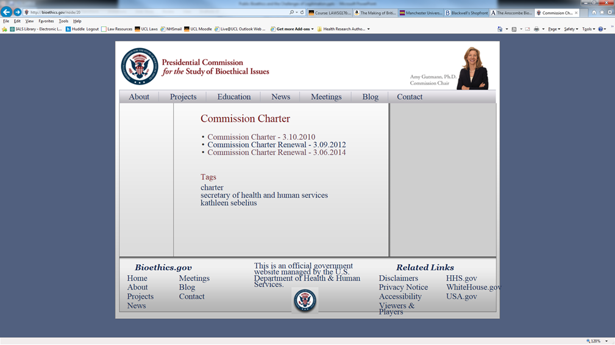
The Presidential Commission for the Study of Bioethical Issues (the Bioethics Commission) is an advisory panel of the nation’s leaders in medicine, science, ethics, religion, law, and engineering. The Bioethics Commission advises the President on bioethical issues arising from advances in biomedicine and related areas of science and technology.

Slide 8
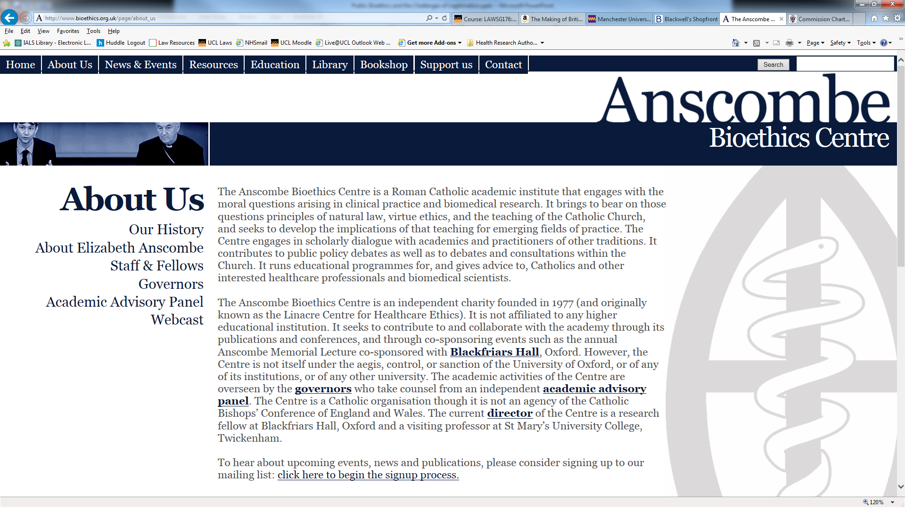
a Roman Catholic academic institute that engages with the moral questions arising in clinical practice and biomedical research. It brings to bear on those questions principles of natural law, virtue ethics, and the teaching of the Catholic Church…. The Centre engages in scholarly dialogue with academics and practitioners of other traditions. It contributes to public policy debates as well as to debates and consultations within the Church.

Slide 9
B Process
Deliberation
Rationality
‘Earned authority’
Roles of consultation

Slide 11


Slide 12
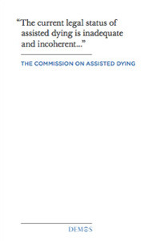
279 submissions
6 public hearings
Judicial endorsement
Parliamentary discussion

Slide 13
C Endorsement
  Implementation
  Incorporation
  Ballot box

Slide 14
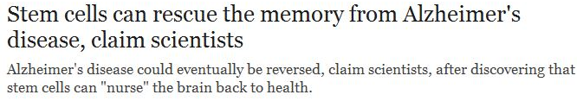
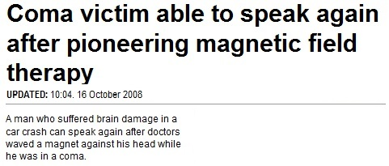
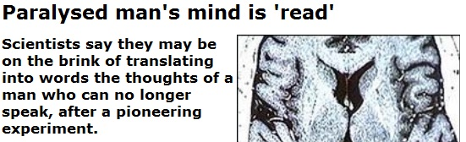
Neurotechnology hype in UK media
How a zap to the brain could bring out the genius in you
Morality is modified in the lab
Notes:
Morality is mod = BBC online 30/03/2010
Zap to brain / genius = Daily Mail 08/02/2011
“Paralysed man’s mind is “read” BBC News Online (15 November 2007)
“Coma victim able to speak again after pioneering magnetic field therapy” The Daily Mail Online (16 October 2008)
“Stem cells can rescue the memory from Alzheimer’s disease, claim scientists” The Telegraph Online (20 July 2009)
Contributions to ‘spiral of hype’
24 hours news cycle
Professionalisation of science PR
Impact agenda in HE and national economic policy
Hype in med/tech journalism
Extrapolation beyond methodology and findings
Focus on ‘miracle’ stories and arresting images
Under-reporting of risks
Uncritical reproduction of press releases
Risks of hyping novel neurotechnologies
Unsustainable hope
Undermine informed consent
Neuro-reductionism
Investment backlash
ALL PARTIES TO REFLECT ON THEIR CONTRIBUTION AND HOW TO DO BETTER
POLICY-MAKERS AND HE TO REFLECT ON UNINTENDED CONSEQUENCES OR IMPACT AGENDA

Slide 16

a novel expertise of ‘bioethics’ claiming the capacity to evaluate and adjudicate…has been enrolled in the government and legitimation of medical practices from bench to clinic and marketplace

Slide 17
