Slide 1
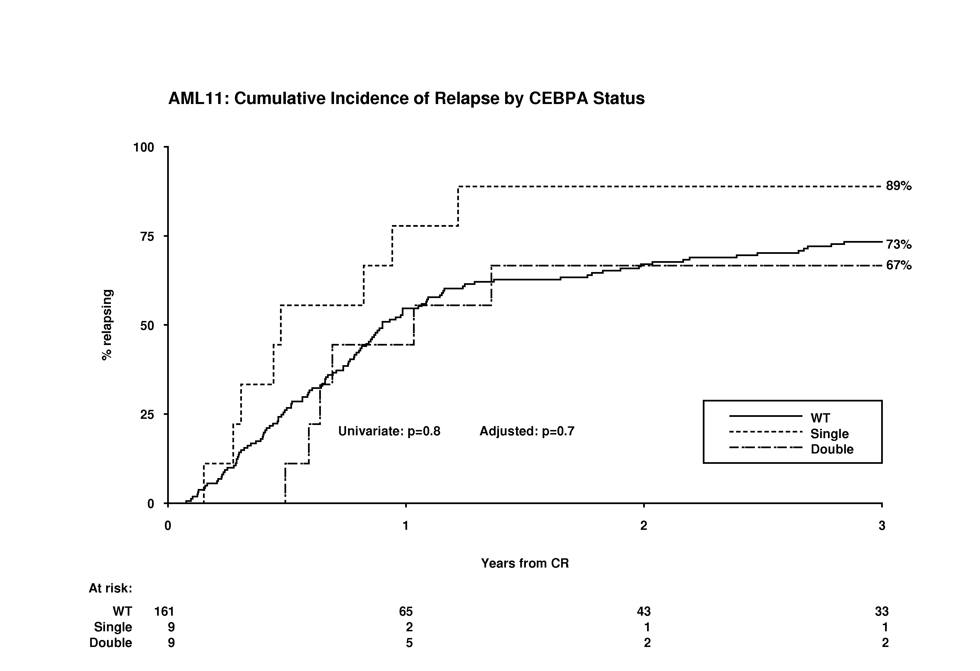
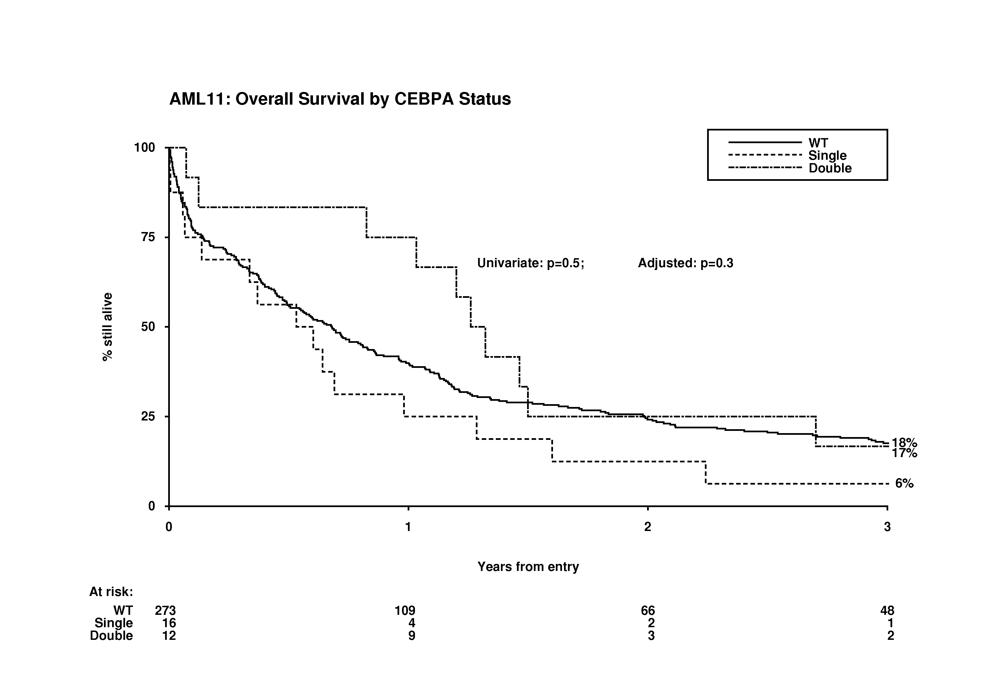
Fig. 2
(A)
89%
73%
67%
% relapsing
Univariate: P=0.8
Multivariable: P=0.7
Years from remission
(B)
Univariate: P=0.5
Multivariable: P=0.3
% still alive
18%
17%
6%
Years from entry

Slide 2
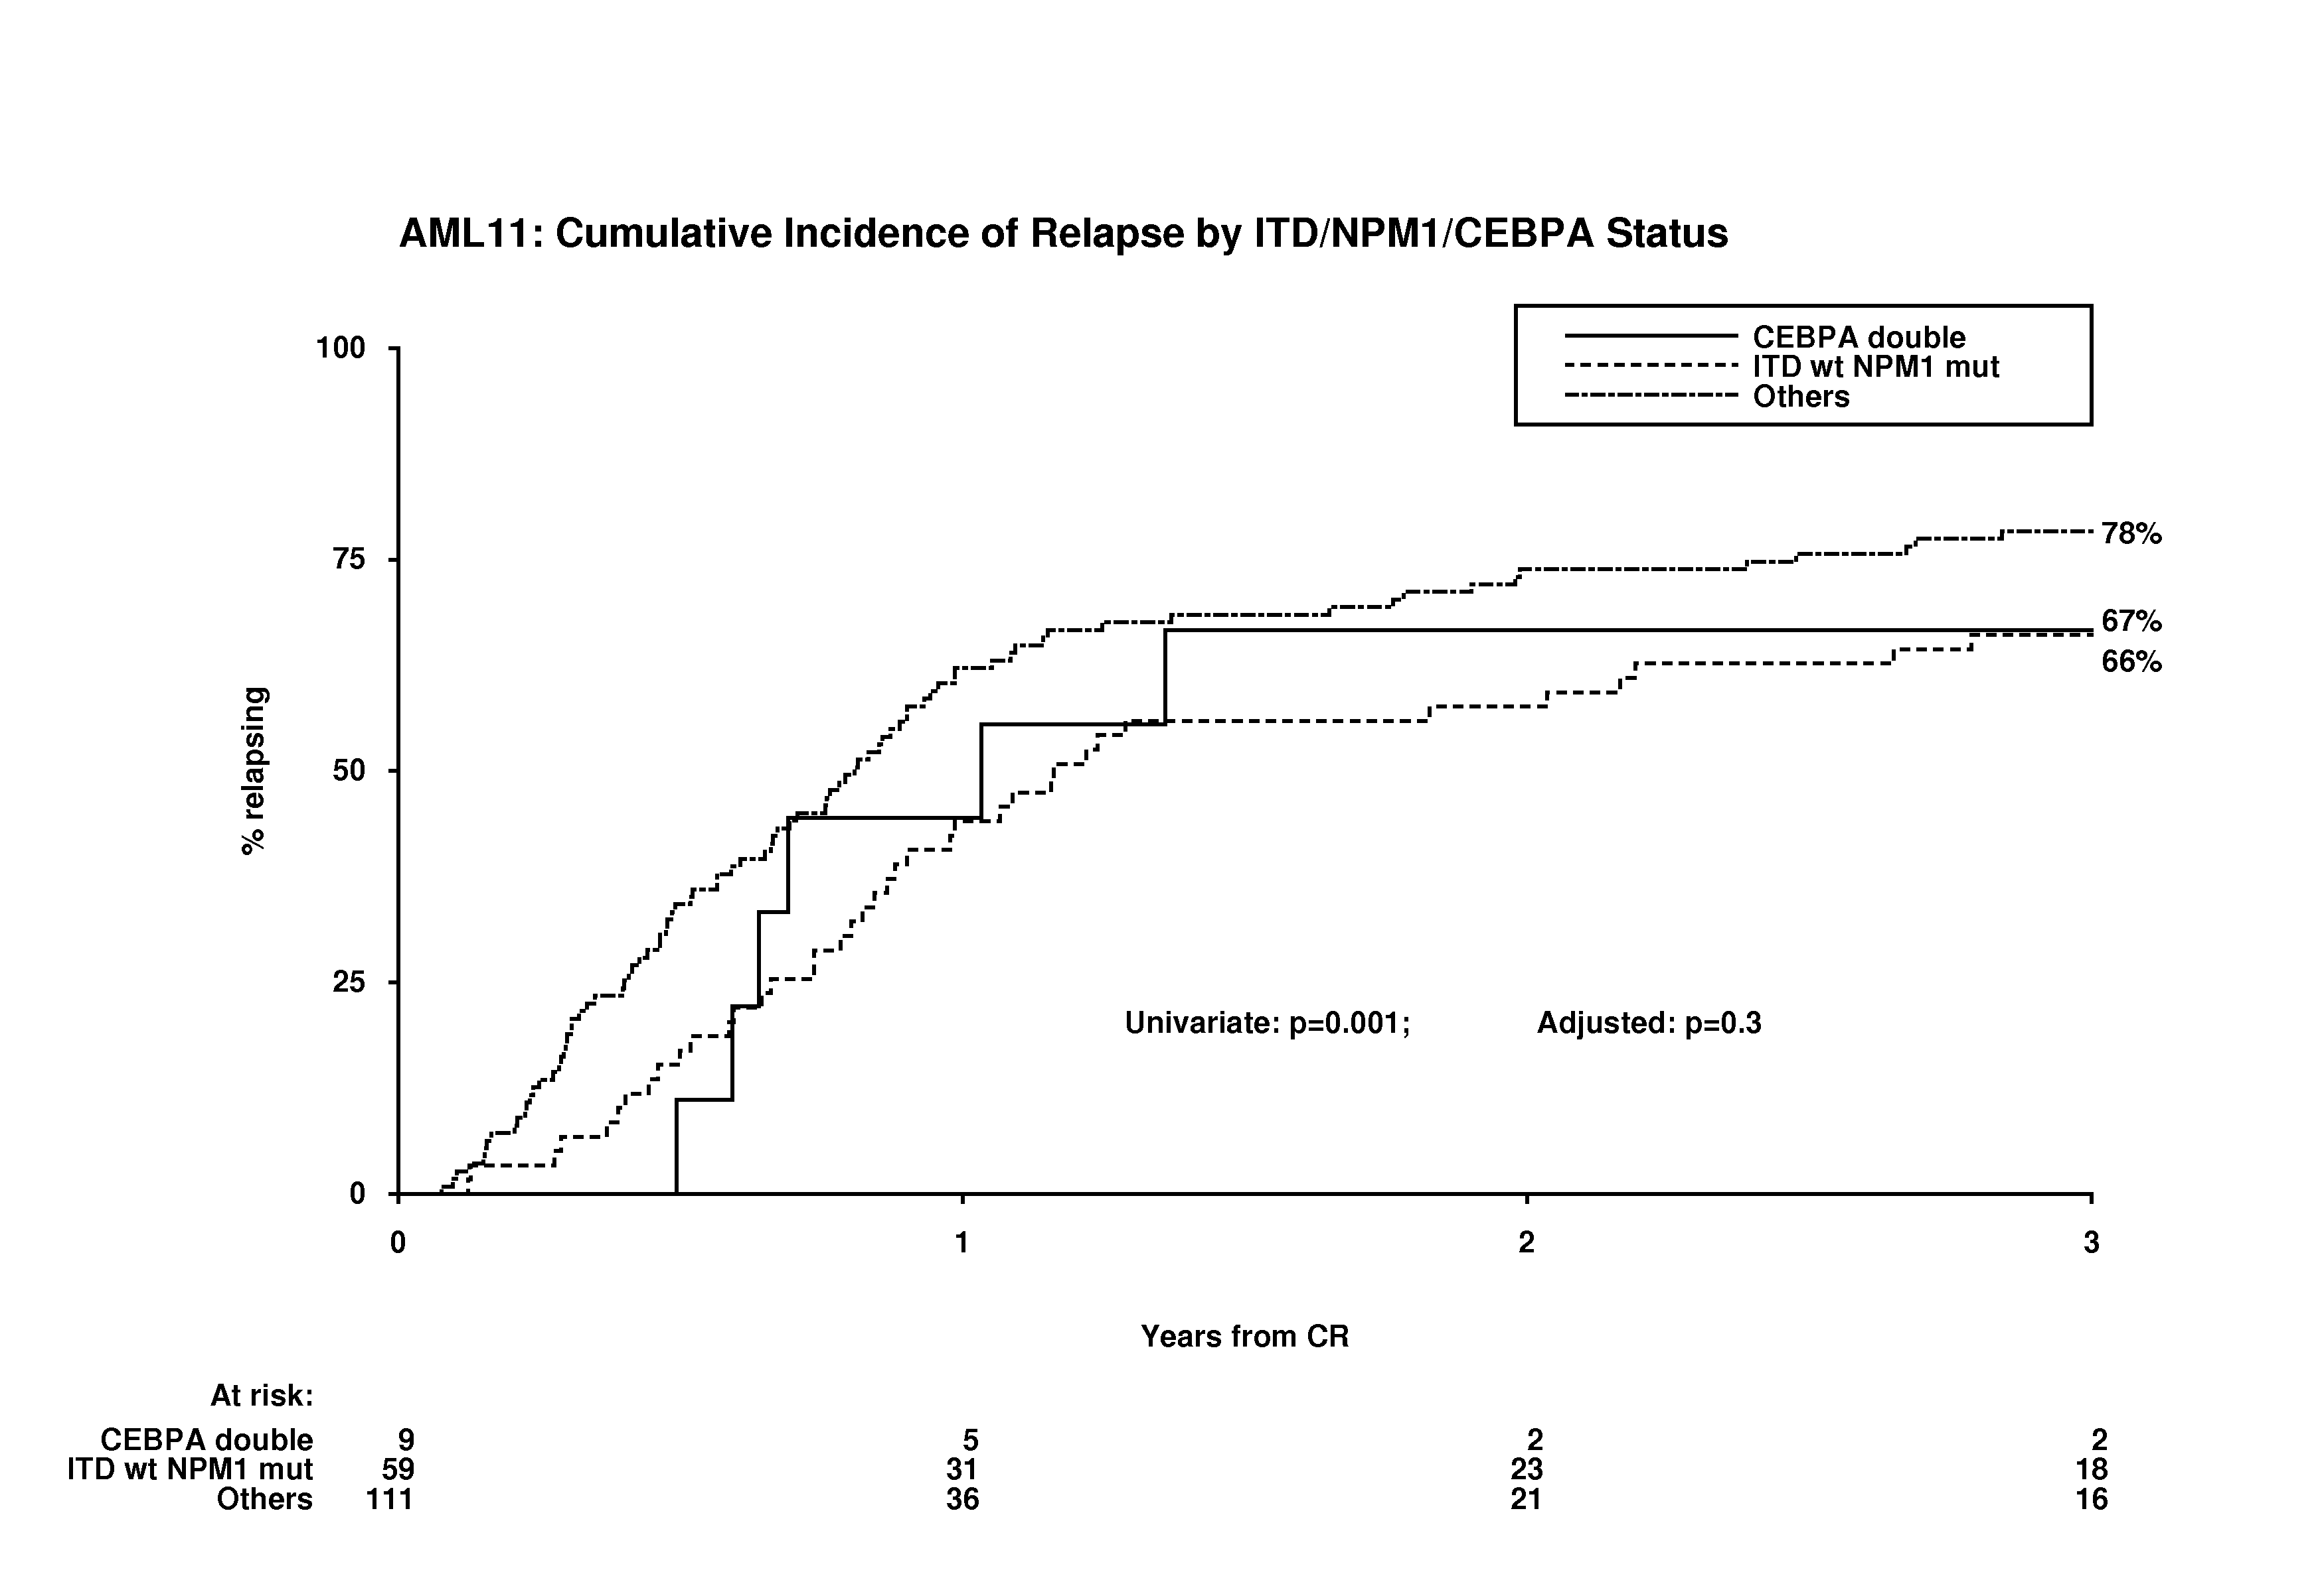
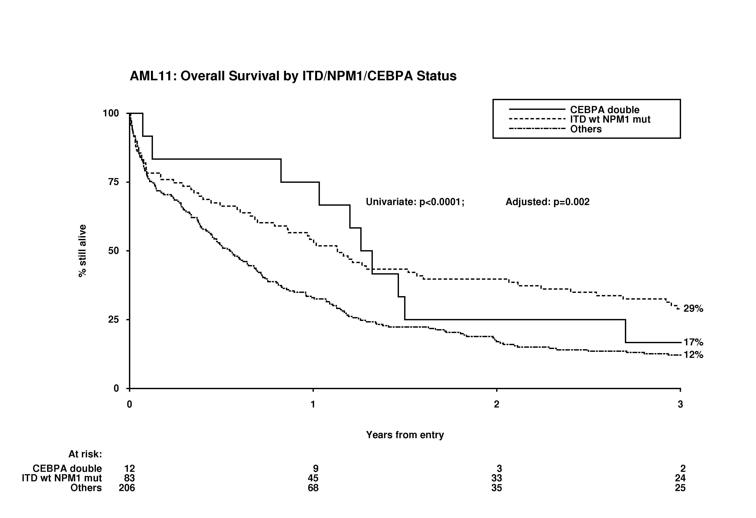
Fig. 3
(A)
78%
67%
66%
% relapsing
Univariate: P=0.001
Multivariable: P=0.3
Years from remission
(B)
Univariate: P<0.0001
Multivariable: P=0.002
% still alive
29%
17%
12%
Years from entry

Slide 3
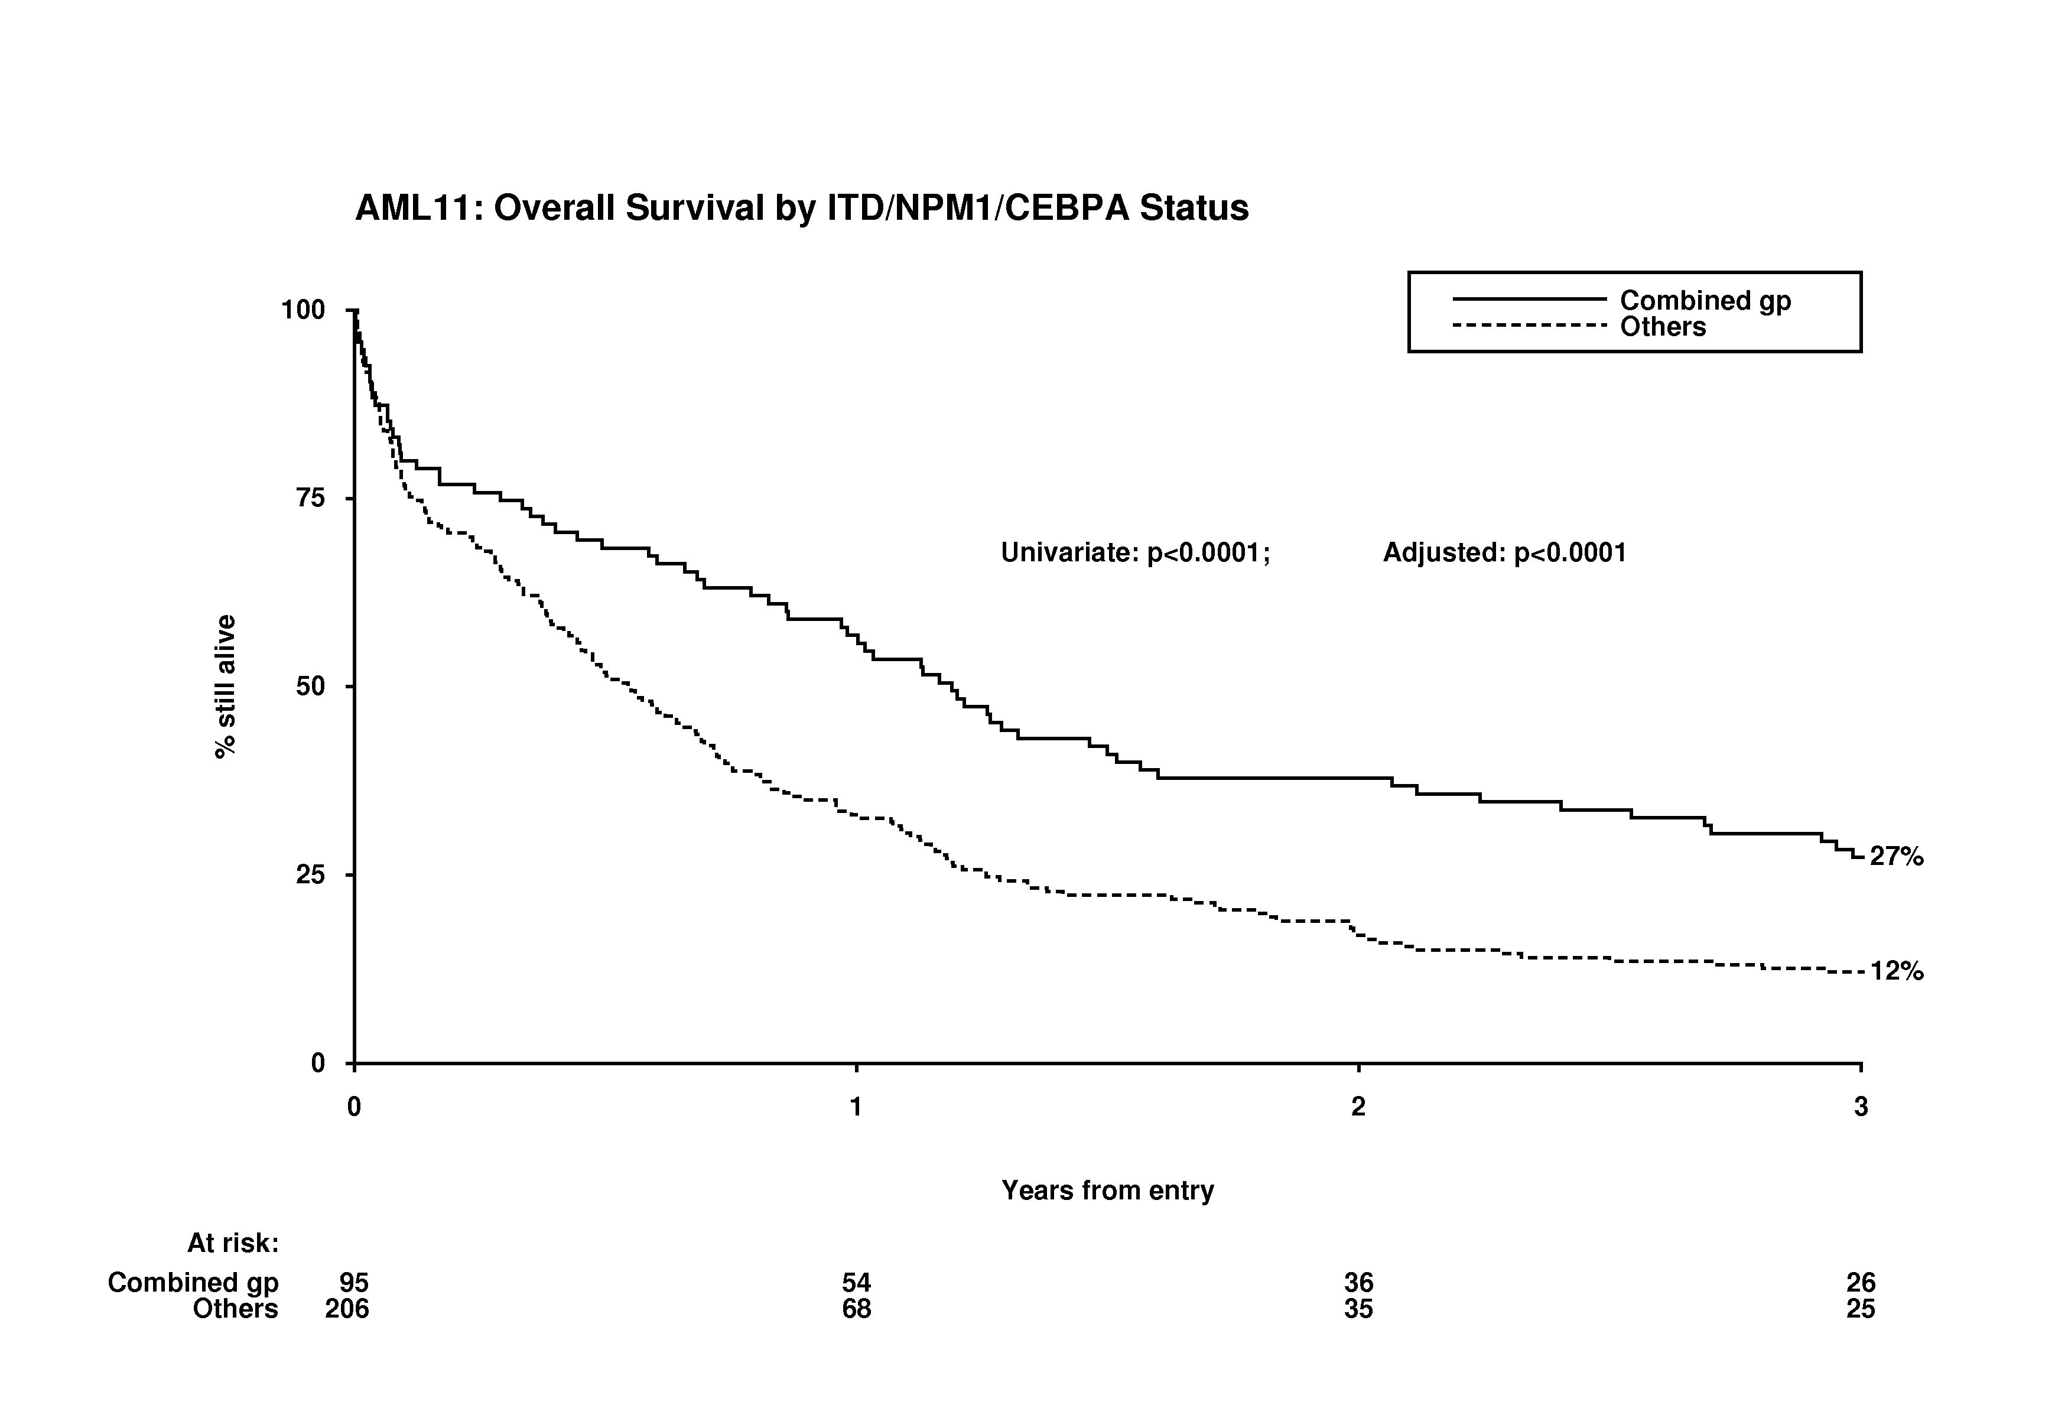
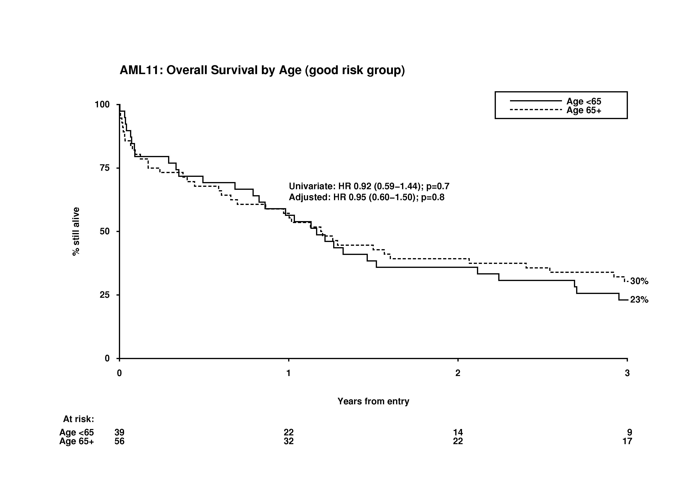
Fig. 3
(C)
Univariate: P<0.0001
Multivariable: P<0.0001
% still alive
27%
12%
Years from entry
(D)
Univariate: P=0.7
Multivariable: P=0.8
% still alive
30%
23%
Years from entry

