Slide 1
Making Open Access work for UK universities and researchers
Professor David Price
Vice-Provost (Research)
d.price@ucl.ac.uk
Dr Paul Ayris
Director of UCL Library Services and CEO UCL Press
p.ayris@ucl.ac.uk

Slide 2

Contents
International Leadership
Costs of OA research data and the OA Gold route
UCL Press
Widening access beyond academia
Wilkins Building, UCL, 1826

Slide 3
Contents
International Leadership
Costs of OA research data and the OA Gold route
UCL Press
Widening access beyond academia
Wilkins Building, UCL, 1826

Slide 4

Win - Win
OA is good for researchers
  Increases citations and impact
Good for HEIs
  Enhanced global recognition
Good for society, industry and public sector
Good for developing world

Slide 5
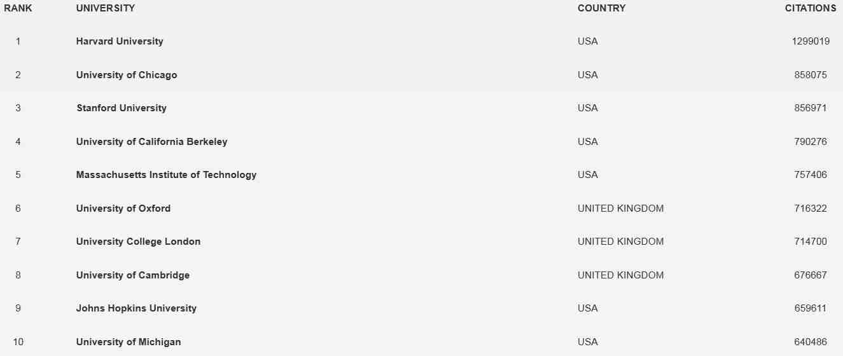
OA drives up citations and impact of work: Google Webometrics Ranking (Jan 2016)...

Slide 6
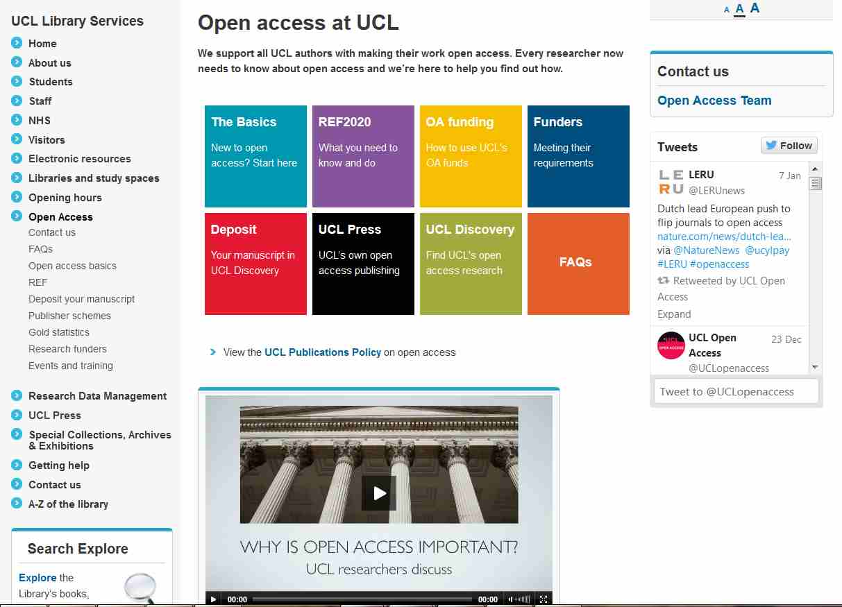
So need investment in OA support...

Slide 7
Increasing take up of deposits:

Slide 9
Contents
International Leadership
Costs of OA research data and the OA Gold route
UCL Press
Widening access beyond academia
Wilkins Building, UCL, 1826

Slide 10
Gold OA at a cost!

Slide 11
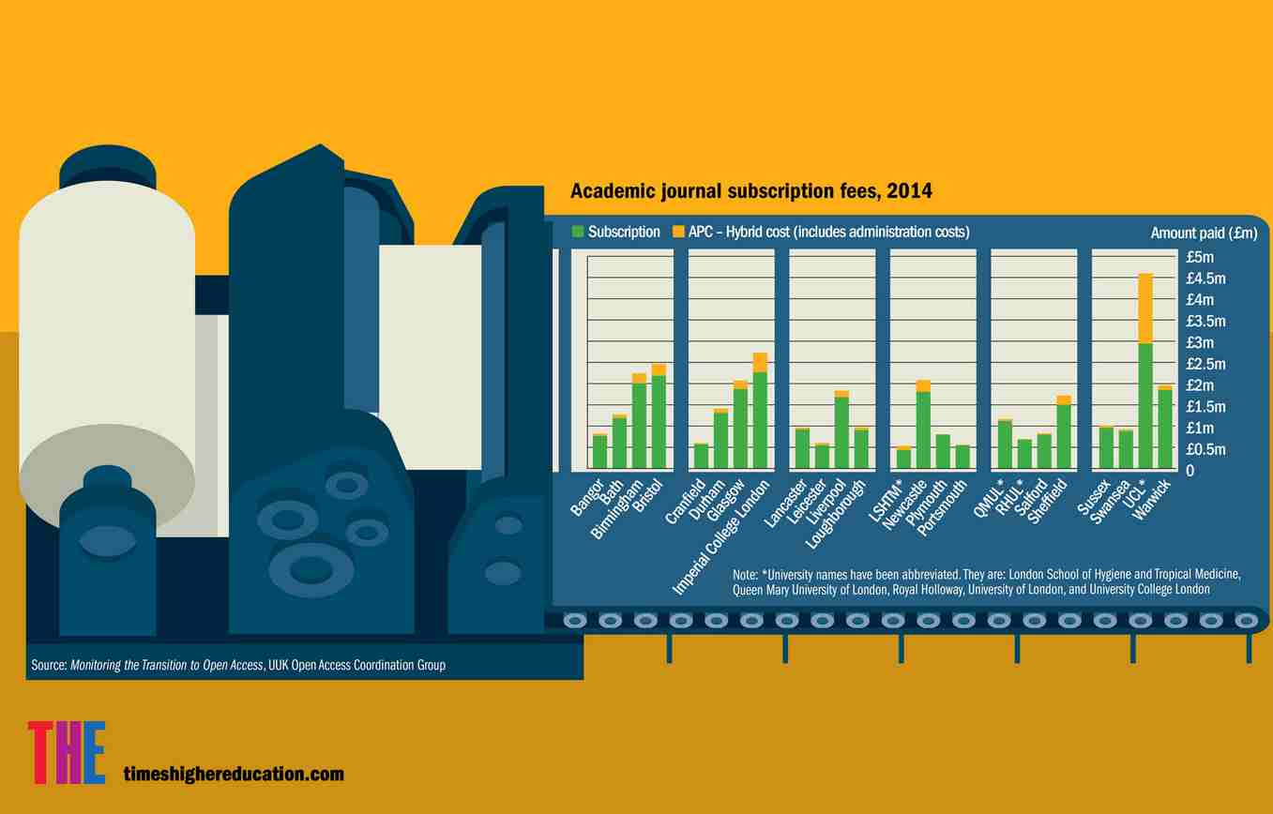
Costs not sustainable for 100% OA....

Slide 12
Funding for OA to Publications in the UK:
Costs of Implementation for RCUK
Research Consulting undertook a study of the costs of OA implementation
APCs
Article Processing Charges
£11 million per annum
Administration
Infrastructure, Advocacy, Management
£9.2 million

Slide 13
Funding for OA in the UK:
Costs of Implementation for HEFCE REF mandate for OA to Publications
Costs of Implementation
£4 million - £5 million
Administration -£9.2 million
Costs of Gold OA administration
£81 per article
1 extra FTE needed for every 500 APCs
Costs of Green OA
£33 per article
1 extra FTE needed for every 1500 repository deposits

Slide 14

Solutions?
A new model for subscriptions?
Green, with mutually agreed embargoes
OA Presses

Slide 15

GOLD OA
LERU issued a Statement on Open Access in November 2015
“Christmas is Over” – research funding should go to research, not publishers
Full cost of ownership (“Double-dipping”) a concern for those with Gold OA policies
  Payment for the subscription AND APCs
LERU calls for offsets of APCs against subscription costs
Over 9,00 organisations & individuals (30/12/15) have signed

Slide 16
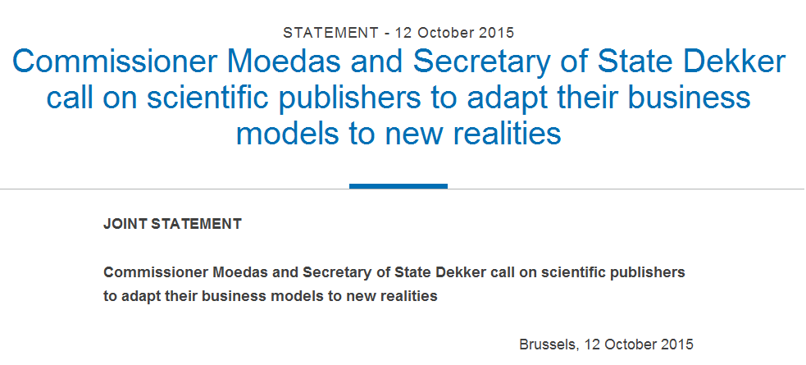
http://ec.europa.eu/commission/2014-2019/moedas/announcements/commissioner-moedas-and-secretary-state-dekker-call-scientific-publishers-adapt-their-business_en

Slide 17
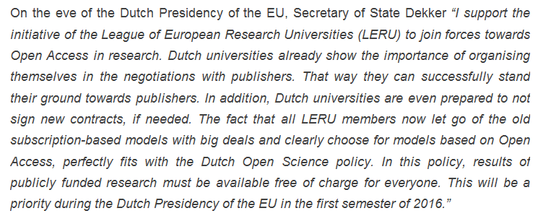

Slide 18

Next Steps
Statement to be presented to Dutch EU Presidency in 2016, today 20 January
Dr Paul Ayris supporting LERU Secretary General in the presentation
LERU preparing issues for Summit in Spring 2016

Slide 19
Contents
International Leadership
Costs of OA research data and the OA Gold route
UCL Press
Widening access beyond academia
Wilkins Building, UCL, 1826

Slide 20


UCL Publishing model
Journal publishing platform
  OJS (Open Journal Systems) overlaying UCL Discovery as storage layer
  Peer-reviewed journals
  Run by academic Editorial Committees
Research Monograph list being launched in 2014-15
  10 titles in year 1
  Using Open Monograph Press
Textbook infrastructure
  Being constructed with JISC project monies
Open Access is an opportunity, not a threat
See http://www.ucl.ac.uk/ucl-press

Slide 21
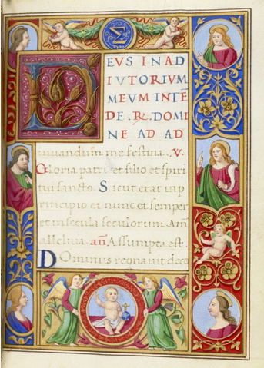
Monograph Publishing
Is Open Access a solution to broken Business Model?
University Press takes on role as monograph publisher
UK’s National Monograph Strategy sees a role for OA monographs
We need to be clear what the future of the scholarly monograph is in a digital world
UCL Special Collections, 15th century Book of Hours, with 19th century additions. MS. Lat. 25

Slide 22
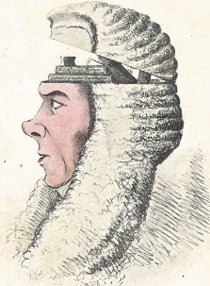
UCL Publishing model
Open Access business model
Books are peer reviewed before publication, and assed by Editorial Committee
Publication free to UCL staff
Charge (~£5k) for non UCL authors.
HTML augmented copies available (as appropriate) via UCL Press
Hard copy via Print on Demand on Amazon or Kindle
A Box of Useful Knowledge
(Brougham Papers, UCL Library Services)

Slide 23









Slide 24
Usage levels
(June 2015 – week ending 18 December 2015)
UCL Press statistics
8 titles via UCL Discovery | 11,008 downloads
Enhanced digital editions (all titles) | 15,328 page views
UCL Press website | 36,674 page views
Sale – all titles (to Nov15) | 881 copies
8 titles via Other Platforms | 628 downloads

Slide 25

Journals... Just starting supporting Faculties

Slide 26
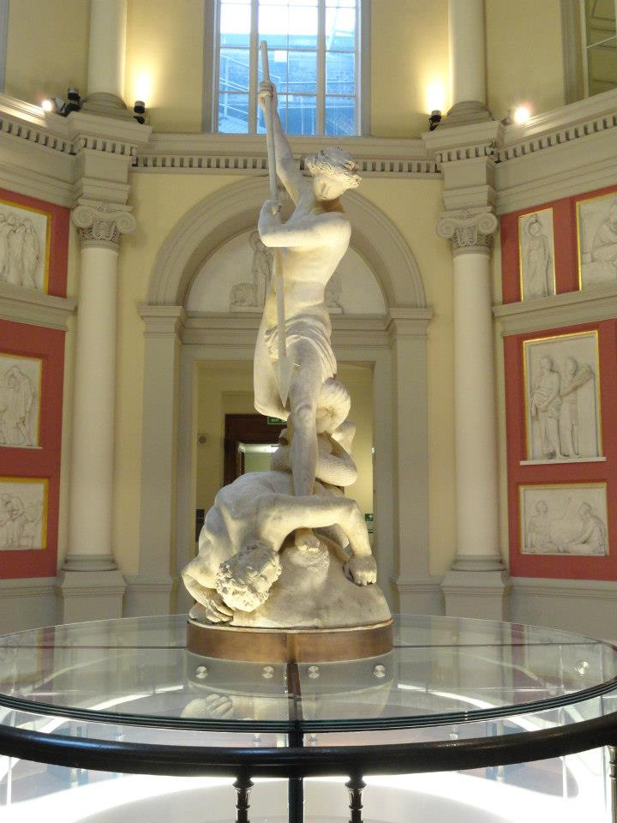
Challenges for Text Books
Students want remote access to core readings 24x7
In the US, just five textbook publishers control more than 80% of the $8.8 billion textbook market
E-book publishers are nervous about making course texts available as e-books (free at the point of use) as they do not want to cannibalize their print sales to students and lose revenue
St Michael, by John Flaxman, UCL

Slide 27

Opportunities for Text Books
Many UCL academics, particularly in Physical Sciences and Engineering, already produce their own textbooks
Open Access is a core value of UCL Press
Open Access to resources will be part of UCL’s new Education Strategy
UCL’s International Strategy will also embrace Open Scholarship as an offering to the global community
COLLEGE COLLECTION PERS
The Centenary edition of the College Magazine, June 1927

Slide 28
JISC Call - Institution as E-Text Book publisher
£75,000 awarded to UCL
To create an Open Access E-Textbook publishing platform
  To complement OJS for journals and OMP for monographs
2 textbooks being delivered as proof of concept
1 in Medical Sciences and 1 in Social Sciences

Slide 29
Contents
International Leadership
Costs of OA research data and the OA Gold route
UCL Press
Widening access beyond academia
Wilkins Building, UCL, 1826

Slide 30

But what if the rest of the world does not embrace OA?
The UK and Holland are leading in Europe on OA
Not all countries are driving this agenda
So how can those in UK that need access, but are out side HE get it?
Licences via Jisc for NHS...

Slide 31

Widening Access to HE-subscribed research content to NHS England
JISC Collections and UCL have worked with publishers for 2 years
2,200 titles can be made available to NHS England for £0.75 million recurrent
Test whether UK National Licence will work
Main barrier is – can NHS England pay?
Decision need by April 2016

Slide 32
Thanks!
Professor David Price
Vice-Provost (Research)
d.price@ucl.ac.uk
@DavidPriceUCL
Dr Paul Ayris
Director of UCL Library Services and CEO UCL Press
p.ayris@ucl.ac.uk
@ucylpay
UCLPress
www.ucl.ac.uk\ucl-press
@UCLpress

