Slide 1
Transport Planning: Turning the Process on its Head
From ‘Predict and Provide’ to Vision and Validate’
Peter Jones
Centre for Transport Studies, UCL
Presentation to the UCLTI Radical Transport Conference, June 20th 2016

Slide 2
Overview
Historically have attempted to predict future conditions and then provide transport measures and infrastructure to meet anticipated demand – ‘predict and provide’
Increasingly this is questioned, due to seemingly greater uncertainty, BUT at same time a growing awareness that cities can INFLUENCE future
UK city regions developing comprehensive visions – paper proposes that we should start with these outcomes and then see what types of investments can be justified to support them – ‘vision and validate’

Slide 3
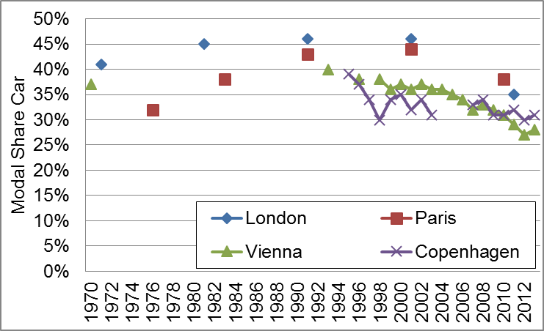
‘Peak car’ in Western European Cities
Source: EU ‘CREATE’ Project

Slide 4
‘Predict and Provide’
Can be traced back to 1960s Urban Land Use/ Transportation Studies:
  Forecast likely growth in car ownership and use
  Demonstrate inability of existing road networks to cope with this increased demand
  Propose major road building to avoid extreme congestion and gridlock (maybe with demand management)
  Iterate until major problems addressed (or budget/political limits reached)

Slide 5
Simplified Description of ‘P&P’ Process
Existing network characteristics
Describe existing (car) travel patterns
Forecast future (car) travel patterns
Forecast (poor) network conditions
Forecasts changes in population, incomes, car ownership….
Develop investment (and management) proposals
Recommended investments

Slide 6
Emerging Issues - 1
In larger cities found that could not build enough roads to avoid heavy congestion if cars freely used
New emphasis on modal shift and improving public transport (‘carrot and stick’)
But still based on forecasting the future and providing for this – so very difficult to predict trend breaks
Better at forecasting negative externalities than positives (e.g. improved health)

Slide 7
Emerging Issues - 2
Increasingly transport seem as contributing major benefits to other sectors
Over time, unreliability of forecasts have became apparent – both road and rail
Growing awareness of ‘uncertainty’ issues, due to global volatility (e.g. oil prices) and technological advances (e.g. automated vehicles)

Slide 9
Responses to this Problem
Development of ‘scenarios’, based on varying assumptions about changes in ‘drivers of demand’ (incomes, fuel prices, etc.)
Emergence of ‘backcasting’ techniques: given a goal or target (e.g. X% CO₂ reduction), how do we get from ‘there’ back to ‘here’, through measures to achieve desired behaviour change?

Slide 10
Road Traffic Forecast Scenarios 2015

Slide 11
Variant: NZ scenario set 2042 (Lyons and Davidson, 2016)

Slide 12
Backcasting (Banister & Hickman, 2013)

Slide 13
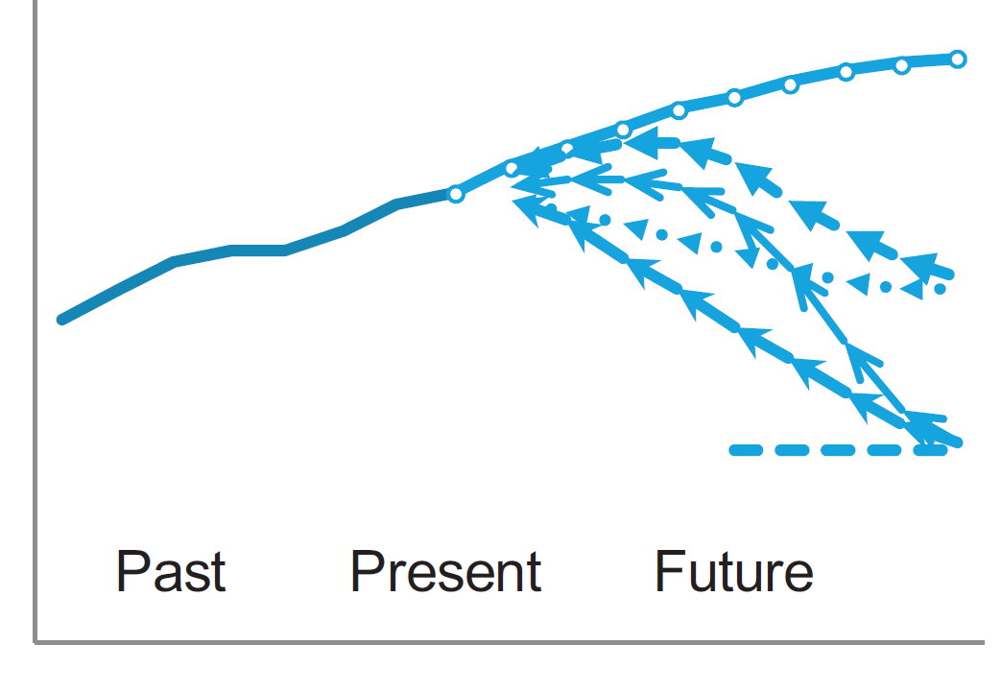
Variant: Scenarios + Backcasting
‘Pluralistic backcasting (Tuominen et al, 2014)

Slide 14
Proposal: ‘Vision and Validation’
Develop comprehensive future city/country vision
Identify what role transport should contribute to delivering the vision: major investments - plus (more flexible) pricing and regulatory measures
Determine under what future set of conditions this major investment would have proved to have provided good value for money
See if the programme can be tweaked to increase robustness – Real Options Analysis

Slide 15
Simplified Description of ‘V&V’ Process
Comprehensive, multi-sector vision for the future development of a city or country
Identify role that transport can play in delivering vision
Develop preliminary set of investment plans
Stress test/validate: under what range of future conditions would this be valid?
Ranges for possible future population, incomes, etc.
Iterate to increase the robustness of the investments
Recommended transport investments

Slide 16
But, would this work?
Many core cities have developed multi-sector visions; also some nations - the ‘Wales we want national conversation’
Now have much better understanding of how transport contributes to meeting other sectors’ objectives
Much easier to identify ranges of possible values of drivers of demand than forecast one set
Multi-sector approach also generally strengthens case for transport investment
More challenging for ‘siloed’ central government

Slide 17
Redefining ‘forecasting’
Forecasting is no longer about second-guessing the future, but about assessing under what range of futures the proposed policy/investment would be valid – helping to optimise the investment package

Slide 18
Thank you!
peter.jones@ucl.ac.uk

