Slide 1

UCL Multimorbidity Project
“Socioeconomic inequalities in health expectancy with and without multiple morbidities”
Madhavi Bajekal, PhD
CEPAR, UNSW Sydney, 7th March 2016

Slide 2
Project essentials
Research Team: (8)
    UCL DAHR: Dr Madhavi Bajekal (PI), Ms Mei Chan, Prof Rosalind Raine
    Farr Institute: Dr Spiros Denaxas, Prof Harry Hemingway
    MRC Medical Bioinformatics Centre, Leeds: Dr Mar Pujades
    UCL Dept of Statistical Science: Dr Ardo van den Hout
    UCL Dept of Primary Care: Dr Melvyn Jones
Funding: Matched funding, industry and academia
  (Legal & General Assurance Society (2 staff) & CLAHRC)
Timeline: Jan 2015 to Dec 2017 (3y)

Slide 3
Advisory Group Membership
Professor Carol Jagger (Chair) AXA professor of Epidemiology of Ageing, Newcastle University
Professor Chris Salisbury Professor of Primary Care, Bristol University
Professor Fiona Matthews Professor of Statistical Epidemiology, Newcastle University and Programme Leader, MRC Biostatistics Unit, Cambridge University
Mr Brian Ridsdale Vice-Chairperson, Mortality Working Group, International Actuarial Association
Dr David Buck Senior Fellow, Public Health and Inequalities, King’s Fund
Professor José Iparraguirre Chief Economist, Age UK
Geriatrician/Social Gerontologist (Advisory decided to suspend recruitment)
Sponsor – Mr Joseph Lu, Director, Longevity Science, Legal & General

Slide 4
Overview
Concepts, Background and Aims
Data and Methods
Operational challenges: Which diseases to include?
First analyses: Representativeness of the CPRD
Project deliverables and timeline
Open discussion and questions

Slide 5

Context
As populations age they acquire more diseases, and receive more treatments
Single disease guidelines rarely represent clinical reality
Little agreement on what constitutes the key aspects of multiple-morbidity (MM)
What are the key issues for patients, clinicians and society?

Slide 6
Concepts and Definitions
What is Multimorbidity (MM)?
  “ the co-occurrence of two or more chronic conditions within one person without specifying an index condition”
  A chronic condition/disease is a “health problem that requires management over a period of years or decades” (WHO)
  Dept of Health defines long-term conditions or chronic diseases as those for which there is currently no cure.
How is it different from co-morbidity?
  No consensus on definition
  Most often defined in relation to a specific index condition of interest, made more complicated by the existence of additional diseases that coexist; or which may occur over the clinical course of the index condition (Feinstein).

Slide 7
Overlapping concepts of ill-health
Long term conditions (less restrictive than term ‘diseases’, eg includes ‘pain’)
Non-communicable diseases (non-infectious or non-transmissible: overlap strongly with, but are distinct from, chronic diseases, eg HIV/AIDS may require long term care but are not NCDs)
Chronic diseases (‘impaired normal functioning typically manifested by distinguishing signs and symptoms’)
Geriatric syndromes (‘accumulated effects of impairments in multiple systems associated with falls, incontinence, weight loss, sensory deficits – but no consensus definition’)

Slide 8
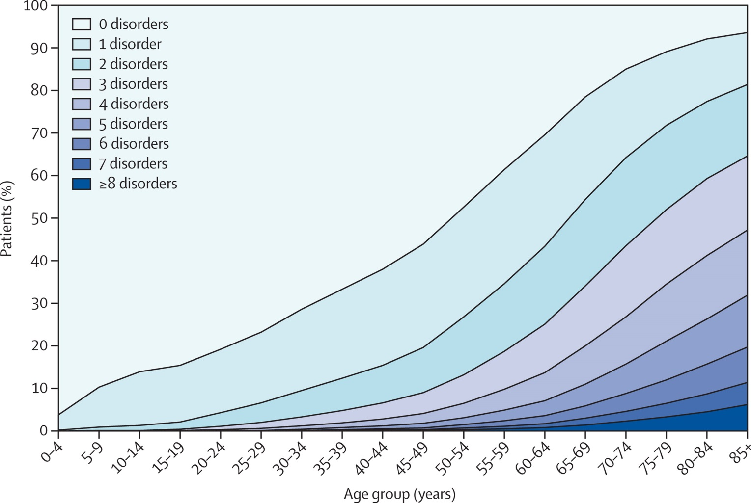
Scotland: prevalence of MM (2+ out of 40 conditions) by age
Karen Barnett, Stewart W Mercer, Michael Norbury, Graham Watt, Sally Wyke, Bruce Guthrie
Epidemiology of multimorbidity and implications for health care, research, and medical education: a cross-sectional study, Lancet, Volume 380, Issue 9836, 2012, 37–43

Slide 9
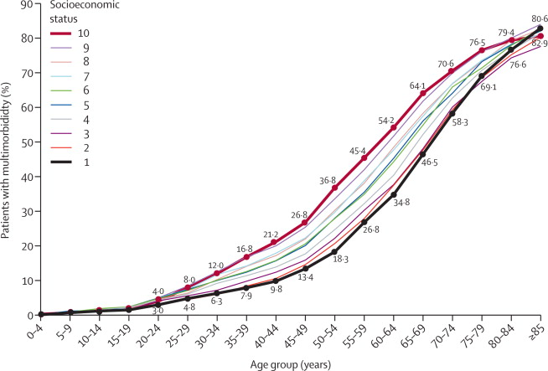
Scotland: prevalence of MM by age & deprivation
Karen Barnett, Stewart W Mercer, Michael Norbury, Graham Watt, Sally Wyke, Bruce Guthrie
Epidemiology of multimorbidity and implications for health care, research, and medical education: a cross-sectional study, Lancet, Volume 380, Issue 9836, 2012, 37–43

Slide 10
Multimorbidity and socioeconomic disadvantage at older ages
What we know is that the level of deprivation affects:
  The age of onset of MM
  The prevalence of MM; burden of disease
  The type of diseases in combination –physical and mental health more common in deprived than in affluent at ages <55
What we don’t know:
  Do older poor die of the same combinations of diseases as rich, but just become morbid earlier in the life course and die younger?
  For similar disease combinations, is disease progression and survival different in deprived and advantaged groups?
  Are the relative risks of survival for major disease combinations additive, multiplicative or does one more lethal disease trump the others?

Slide 11
Project Aims
Two approaches to investigate the impact of socioeconomic inequalities:
  Disease-count based approach: estimate the differential rates of transition between health states and partition total life expectancy into years with and without disease (0,1,2,3+ diseases).
  Disease cluster-based approach: What are the common disease clusters? For patients with the same combination of diseases, does the mortality risk vary by socioeconomic deprivation?

Slide 12
‘Big Data’ – linked Electronic Health Records
Clinical Practice Research Datalink (CPRD)
  Complete clinical record of each registered patient in 225 linked practices in England (c. 2 million patients or 3% of the population)
  Longitudinal dataset originating from routine general practice encounters (‘real-world’ data), anonymised and available electronically
  Linked data from 1997 onwards to present (our extract data ends March 2010)
  GP consultations (recording symptoms, diagnoses), prescriptions, diagnostic tests, hospital referrals;
  For practices which have agreed to link their patient records to other electronic health sources, additional information includes:
    Hospital admissions: inpatient, maternity and outpatient (via HES)
    ONS Death – with underlying cause of death, including mentions
    Deprivation status (IMD 2007) of patient’s address – via postcode
    CALIBER – also linked to myocardial infarction disease registry (MINAP)
NB: CPRD is a sub-set of the ‘old’ GPRD dataset – about half the GPRD practices agreed to linkage and these are included in the CPRD database.

Slide 13
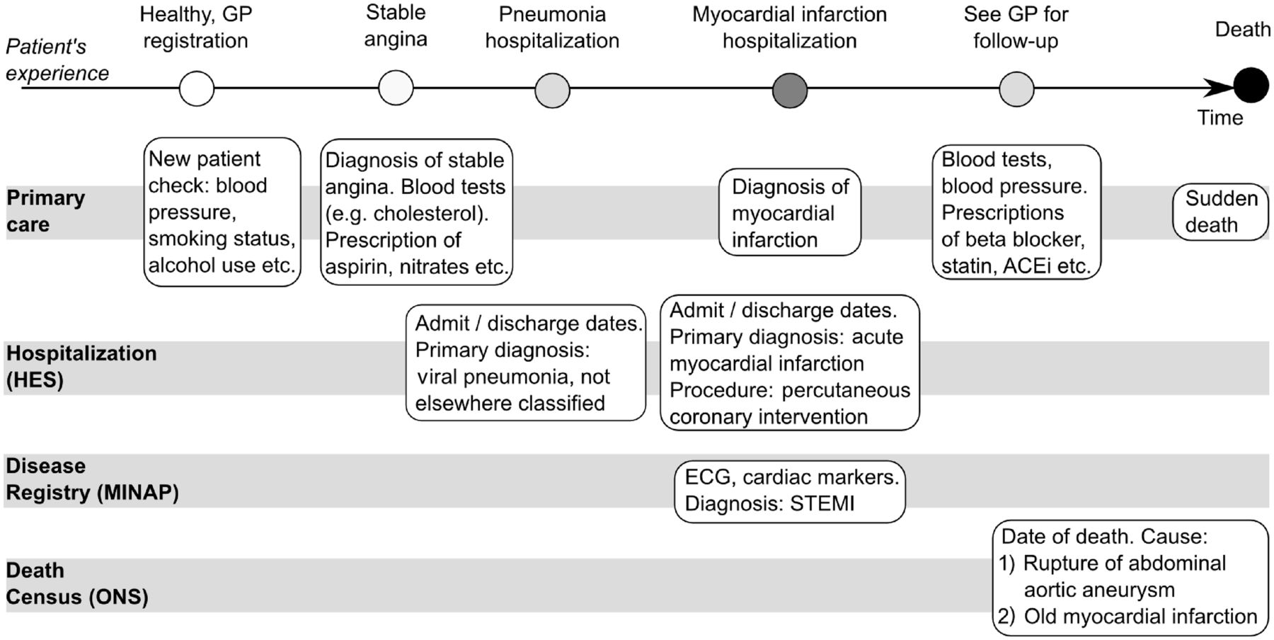

Longitudinal nature of multiple linked data sources in CPRD. ECG = Electrocardiography, STEMI = ST-segment elevation Myocardial Infarction, ACEI = Angiotensin-converting-enzyme Inhibitor.
Spiros C Denaxas et al. Int. J. Epidemiol. 2012;ije.dys188
Notes:
Longitudinal nature of multiple linked data sources in CPRD. ECG = Electrocardiography, STEMI = ST-segment elevation Myocardial Infarction, ACEI = Angiotensin-converting-enzyme Inhibitor

Slide 14
Cohort specification
Inclusion criteria
Open cohort design, with individuals becoming cohort members on the earliest date that all three of the following criteria were fulfilled, which was designated the ‘index date’:
  Registered in linked practices
  UTS (up to standard) practice for at least 1 year
  All patients aged 45 and over on Jan 1st 2001 and those who turn 45 between 1st Jan 2001 and 25th March 2010, irrespective of initial health status.
Exclusion criteria
Patients with missing or incomplete postcode/deprivation score
Patients’ follow-up censored at the earliest date of death, deregistration from the practice, last data collection for the patient’s practice, or the overall study end date.
End of study date (25th March 2010 – end of CPRD dataset)

Slide 15
Research Methods
Disease-count based approach: models transitions from healthy to diseased states (1, 2+ or 1,2,3+ diseases) and death, by deprivation quintiles and gender
    Method: Multi-state modelling using R + ELECT (add-on)
Disease-cluster based approach:
  Identify the main disease clusters and common combinations
    Method: Cluster analysis
  Model socio-economic differences in survival for the main disease clusters:
    Method: Cox proportional hazard model adjusted for covariates (eg age, sex, smoking, and BMI)
    Cluster-based MSM, 3-state ‘healthy- cluster-death’ model

Slide 16
Multistate survival model
h(t)
Alive (s1)
Dead (s2)
2-state survival model
h_{1,2}(t)
Healthy (s1)
Disease (s2)
h _{1,3}(t)
h _{2,3}(t)
Dead (s3)
3-state illness-death model

Slide 17
Our MSM model
At least 3 live states (healthy, 1 disease, 2+ diseases); plus absorbing state of death (4 states)
Progressive: i.e. no recovery
Timescale for modelling is patient age
Adjusted for covariates – incl smoking, blood pressure
R package (MSM) + ELECT
Healthy (s1)
1 Disease (s2)
2+ Diseases (s3)
Dead (s4)

Slide 18
MSM model assumptions
Patients are assumed to transit from State 1 (healthy) to State 2 (1 disease) to State 3 (2+ diseases) in sequence. In practice, can move directly from s1 to s3 (by assuming an instantaneous sojourn between s2 and s3 transition). They can move from any intermediate (live) state to death.
Disease state definition: Age at entry is age at first diagnosis. Assumption: time interval between consultations is short enough to give exact time of disease onset
  Health seeking behaviour: gender and deprivation affect timing of diagnoses
  Recording of diagnoses inconsistent between practices and over time
Markov assumption: the duration of being in a state does not affect the transition to the next state.
Model needs exact ages: CPRD ages set to 1st Jan of each year. Randomise date of birth (using ONS distribution of birthdays in a year)
Computational limitation: data size too large; random subsets might be needed. Could be a strength – multiple runs for internal validation.

Slide 19
Mock-up of MSM-ELECT output eg Inequalities in LE@45 by years spent in different health states
Age

Slide 20
Mock-up of MSM-ELECT output eg life expectancy by age, split into years healthy, 1 disease and 2+ diseases for affluent men aged 45-80
Age

Slide 21
Multimorbidity Clusters: pattern in 65+
16.8%
0.8%
10%
Men
Women
Cardiometabolic 21.2%
Mechanical 33.3%
9.8%
1.1%
26.4%
Psychogeriatric
3.5%
Psychogeriatric
2.4%
Cardiometabolic
17.3%
Mechanical 13.6%
Abad-Diez et al: BMC Geriatrics 2014

Slide 22
Classification of MM clusters
Many cluster typologies
Valderas et al subdivide clusters into non-etiological (no causal association between diseases) and etiological, of which there are 4 models, namely:
JM Valderas, B Starfield, B Sibbald, C Salisbury, and M Roland. Defining comorbidity: Implications for understanding health and health services. Ann Fam Med, 7:357–363, 2009
a)Direct causation | One of the diseases may cause another in the causal pathway (diabetes and peripheral arterial disease)
b)Associated | The risk factors for diseases are correlated – eg smoking and drinking – so COPD and liver disease co-occur
c)Heterogeneity | Risk factors are not correlated – eg smoking and age – but affect both diseases (lung cancer and CHD)
d)Independence | The presence of the diagnostic features of each disease is actually due to a third distinct disease

Slide 23
Disease clusters – our approach
Two parallel approaches
  Clinical clusters (based on known aetiology, case management, and literature review)
  Statistical clusters
Why 2 approaches –
  Better integration and clinical relevance (‘makes sense’)
  Statistical clustering may reveal unusual/hidden disease patterns by socioeconomic groups
  Disease trajectories? – ie extend the MSM model to examine impacts of age and socioeconomic deprivation on transitions from a single cluster to more than one cluster
Heterogeneity in methods used for statistical clustering: eg hierarchical, factor analysis, latent class models

Slide 24
Operational challenge: Which diseases to include?

Slide 25
Hypertension*
Obesity*
Diabetes
COPD
Asthma
High cholesterol*
Cancer (malignant)
CHD (angina, heart attack)
Depression
Osteoarthritis
Stroke
Thyroid disorder
Renal failure (CKD)
Anxiety
Osteoporosis
Dementia
Rheumatic Arthritis
Heart Failure
Chronic back pain
Other arthritis
Listing long-term conditions based on prevalence/frequency
Selecting TOP 5 – misses out Cancer
Selecting Top 10 – misses out a patient with hypertension, kidney failure, heart failure and osteoporosis
Selecting Top 20 – misses out patients with diseases like Parkinson’s or liver disease
Risk factors* or chronic diseases?
* hypertension, hyperlipidaemia, hyper cholesterol
From: Mercer S, Salisbury C, Fortin M: ABC of Multimorbidity, Wiley 2014.
Disease Prevalence

Slide 26
Issues – which diseases?
Considerable methodological, conceptual and clinical challenges
  No clear break point
  No consensus on number or type of diseases to include
  Always easier to justify adding a disease (but need to be aware of ceiling effect)
  Low prevalence but serious disease like motor neurone disease (MND)
Each disease requires 10-20 hours to produce a final, approved code list/algorithm (Read code + ICD10)
Other Issues: defining chronicity (eg depression), coding changes over time, is it a disease or risk factor?

Slide 27
Selection criteria and literature review
Key considerations
  strong link with mortality eg cardio vascular disease (CVD),
  known serious combinations eg serious mental illness and CVD,
  have a strong social gradient eg long standing depression,
  highly prevalent eg chronic obstructive pulmonary disease (COPD)
  avoid double-counting; excl conditions not coded consistently or well by GPs
Systematic lit review search of papers published from 2000 onwards, 28 studies included satisfying criteria (from 1491 papers)
Recommended number of conditions to include?
  Minimum of top 11/12 diseases prevalent in primary care
  But this may exclude patients with conditions such as kidney disease and Parkinson’s disease
  20 diseases captures 70% of MM burden
Lack of evidence on combinations that are lethal
Combination of mental illness and physical conditions – prevalence is socially-graded, highly associated with mortality but inconsistently recorded.

Slide 28
Selection Process – diseases in-scope
Systematic Review
  28 articles identified
  10 key conditions identified as ‘essential’ by review
    Hypertension (excluded), depression, coronary heart disease (CHD), diabetes, chronic obstructive pulmonary disease (COPD), cancer, stroke or transient ischaemic attack (TIA), chronic kidney disease (CKD), atrial fibrillation (AF), heart failure and dementia
Added 7 from QOF (ie all 20 QOF conditions included)
Barnett (Lancet 2012)
  Added 12 more diseases from the list of 40 long-term conditions Barnet had identified as important
Other (Added MND)

Slide 29
Expert panel
Internal study group
  Generate possible disease list
  Based on literature review + QoF (Quality and Outcome Framework)
  Clinician overview (GP, clinical epidemiologist)
External topic experts
  Chris Salisbury (Bristol), Bruce Guthrie (Glasgow), Jose Almirall (International Research Community on Multimorbidity, U of Sherbrooke, Canada).
  Comments / modifies
Advisory Committee
  Multidisciplinary- clinical, epidemiological, actuarial, data scientists and statisticians - feedback
  Agree final list
Notes:
Qof prevalence or burden of disaases
Suggestion that may have been picked as amenable to change to reduce health inequality

Slide 30
List of diseases in-scope (30)
Asthma or COPD or bronchiectasis | Epilepsy | Anxiety
Depression (ever + SSRI last year) | Dementia or Alzheimer's | Alcohol problems
Diabetes | Heart Failure | Psychoactive substance misuse
Coronary Heart Disease | Peripheral Arterial Disease | Diverticular disease of intestine (..itis Not ..osis)
Hypothyroidism | Rheumatoid Arthritis | Prostate disorders
Chronic Kidney Disease (CKD 4,5) | Learning Disabilities | Glaucoma
Cancer (in last 5 years) | Osteoporosis | Psoriasis
Stroke or TIA | Inflammatory Bowel Disease | Chronic liver disease
Atrial Fibrillation | Multiple Sclerosis | Motor Neurone Disease
Severe Mental Illness | Parkinson's disease | Osteoarthritis (meds + cons) or Chronic severe back pain
Notes:
Back pain – can be acute episode and can be cured (ie therefore not chronic) hence rejected from previous list. If difficult to define chronic and severe back pain using a combination of frequency of contact for back pain in last year, plus medications prescribed and any injections or other interventions. Else most middle-aged people will have one episode of back pain ‘ever-recorded’.

Slide 31
CPRD representativeness by deprivation

Slide 32
CPRD – overall numbers
 | GPRD (all practices) 2007 | CPRD (linked practices) 2007 | England 2007
Population count (all ages) | 3,187,261 (6.2%) | 1,621,118 (3.2%) | 51,261,945
Number of practices | c 500+ (?) | 225 | 7,900
Percentage Female | 50.5% | 50.6% | 50.8%
Median age group | 40-44 | 35-39 | 35-39
Crude death rate (per 1000) | 9.1 | 9.2 | 9.2

Slide 33
Population sampling fraction 2007, by age and sex

Slide 34
Population sampling fraction in CPRD-linked practices by age and deprivation quintile

Slide 35
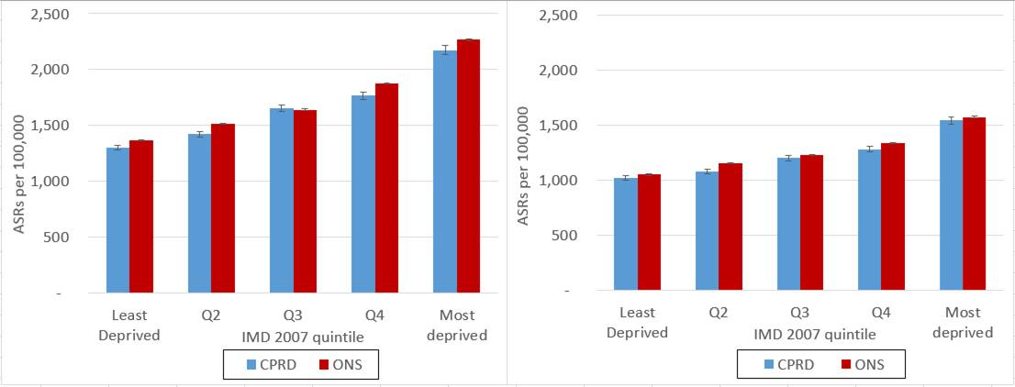
Age-standardised mortality rates by deprivation quintile, 2007. England vs linked CPRD
Men (ages 25+)
Women (ages 25+)

Slide 36
Provisional comments on CPRD representativeness by deprivation analysis
Least deprived population (Q1, Q2) over-represented compared to most deprived (Q5). England estimates will need to be reweighted to compensate.
ASMRs lower in CPRD across most deprivation quintiles for men – healthier population sample?
Next Steps:
  Trends in ASMRs CPRD vs England, 2001-2009 by deprivation
  Supply side variables (staffing) - if possible list size, GPs
  Institutional population – older people (65+) in residential/nursing homes vs Census

Slide 37
Project Deliverables

Slide 38
Deliverables: flow chart
CPRD extract
c.1.3M patients
MSM for 0,1,2,3+ conditions
Disease-cluster based analysis
Define eligible population - age 45+, linked UTS practices, 2001 -10
Disease-count
based analysis
Define in-scope chronic diseases (c 30), code diseases
Define disease clusters
MSM for selected clusters/ disease combinations
Cox Hazard model for selected clusters
Descriptive analysis
Age- sex- deprivation- incidence & prevalence
Secondary
Analyses
Representative-ness of CPRD
CVD-free LE trends, by deprivation
Papers

Slide 39
Discussion and questions
Are the methods appropriate for the analyses proposed?
Are we missing important research questions which could be added without big workload implications?
Please feedback via email to:
    m.bajekal@ucl.ac.uk or
    mei.chan@ucl.ac.uk
Thank you

Slide 40
Project Funding & Disclaimer
This presentation demonstrates independent research and was funded (in part) by the National Institute for Health Research Collaboration for Leadership in Applied Health Research and Care (NIHR CLAHRC) North Thames at Bart’s Health NHS Trust.
The views expressed are those of the author(s) and not necessarily those of the NHS, the NIHR or the Department of Health.

Slide 41
What is an NIHR CLAHRC?
NIHR Collaborations for Leadership in Applied Health Research and Care (CLAHRCs) are partnerships between universities, health and other organisations which have come together to conduct ground breaking applied health research that will have a direct impact on the health of patients with long term conditions and on the health of the public.

Slide 42
Stay in touch with NIHR CLAHRC North Thames
Website
www.clahrc-norththames.nihr.ac.uk
Email: clahrc.norththames@ucl.ac.uk
Twitter:
@CLAHRC_N_Thames

Slide 43
Spares

Slide 44
Project timeline

Slide 45
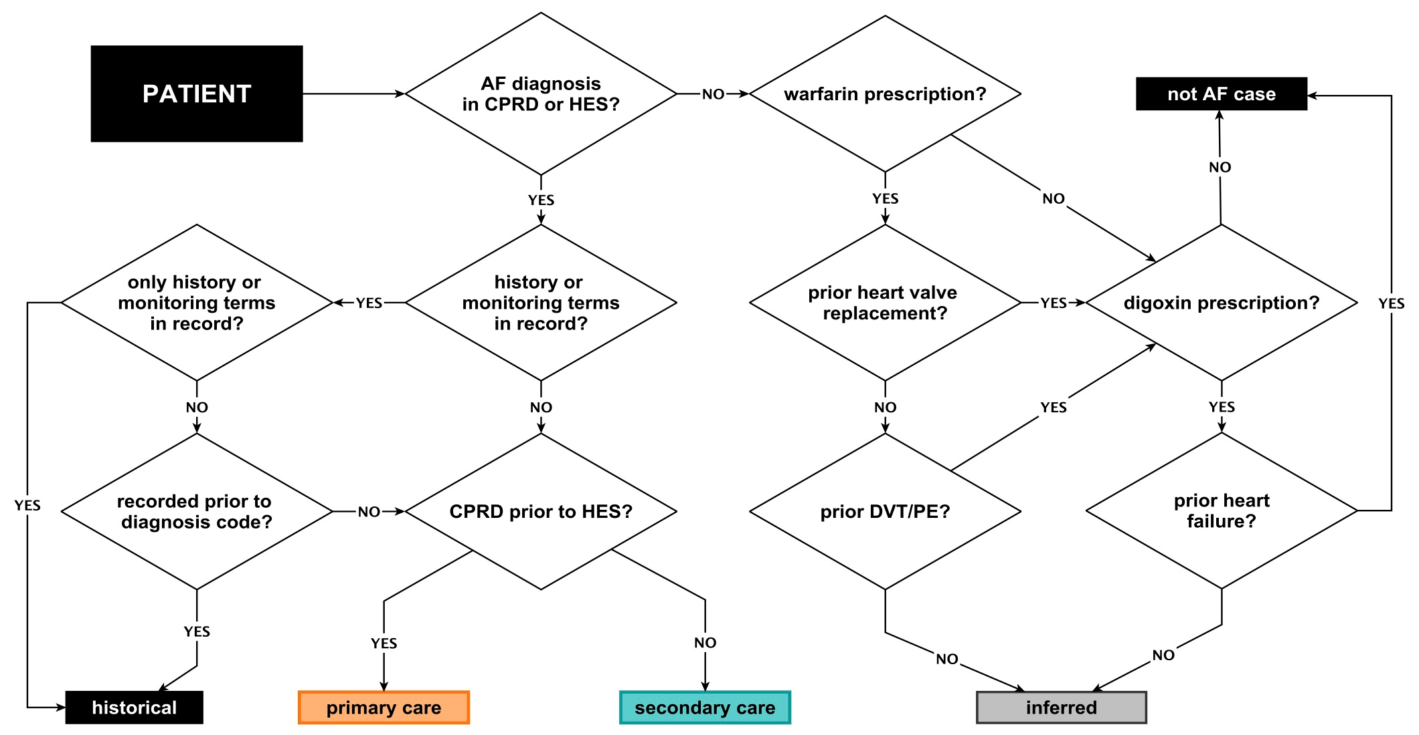
Example of phenotyping AF in CPRD
Diagnosis (READ and ICD10 code)
Medication (prescriptions)
Surgical interventions (OPCS in HES and READ)

Slide 46
GP consultation rates – 2005
(Q-research)
GP Consultation rate
Avg interval in months between GP consultations

Slide 47
References
Barnett K, Epidemiology of multimorbidity and implications for health care, research, and medical education: a cross-sectional study Lancet 2012; 380: 37–43
Huntley AL, Measures of multimorbidity and morbidity burden for use in primary care and community settings: a systematic review and guide. Ann Fam Med. 2012 doi: 10.1370/afm.1363.
Diederichs C, (2011). The measurement of multiple chronic diseases- a systematic review. J Geront A Biol Sci Med Sci. 2011 March: 66A(3): 301-311.
Salisbury C. Epidemiology & impact of multimorbidity in primary care.. BJGP 2011 DOI:10.3399/bjgp11X548929
Cooke G. Common general practice presentations and publication frequency. 42, 1, Jan 2013

Slide 48
Linking deaths and diseases – CPRD deaths: number of mentions
Most affluent Males, 45+
Project 2
Notes:
60% of cases have ½ mentions per MCoD
Generally, more MM , more mentions (as shd be)

Slide 49
Case study: Male, 75-79, Deprivation Q3 (middle quintile)
Death record - MCoD
CPRD record
Underlying cause of death: Chronic ischaemic heart disease, unspecified (I25.9)
Mentions:
Congestive heart failure (I50.0)
Other specified respiratory disorders (J98.8)
Chronic ischaemic heart disease, unspecified (I25.9)
Atrial fibrillation and flutter (I48)
Peripheral vascular disease, unspecified (I73.9)
Cerebral infarction due to unspecified occlusion or stenosis of precerebral arteries (I63.2)
Chronic kidney disease, unspecified (N18.9)
Abdominal aortic aneurysm, without mention of rupture (I71.4)
Chronic diseases recoded by GP
(out of 30 chronic diseases in-scope for MM project)
Stroke or Transient Ischaemic Attack
Heart failure
Peripheral arterial disease
Atrial fibrillation
Coronary heart disease
Chronic kidney disease (Stage 4-5)
Hypertension

Slide 50
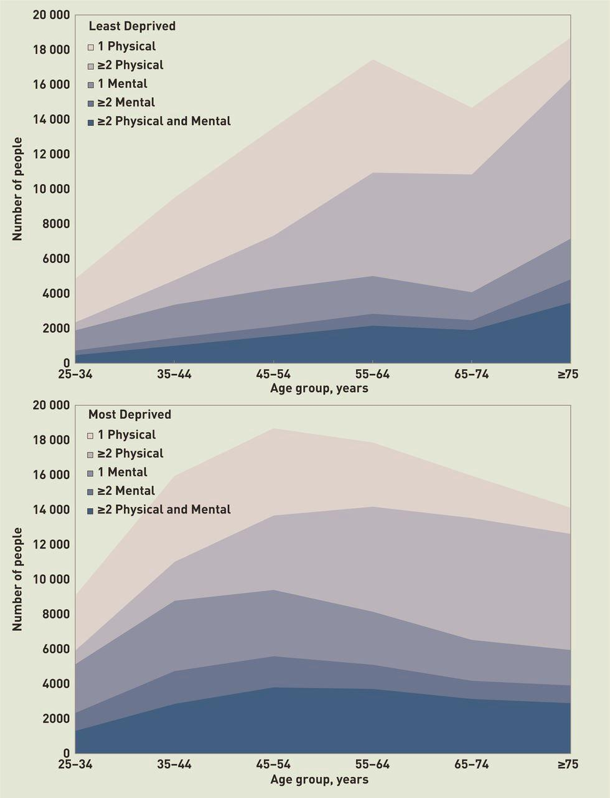
Multimorbidity burden and SES
It is strongly related to deprivation (Salisbury et al, BJGP 2011)
It occurs 10-15 years earlier in deprived groups (Barnett et al, Lancet, 2012)
Differential starts at young ages, and is most pronounced for mental conditions (McLean et al BJGP, 2014)
Gary McLean et al. Br J Gen Pract 2014;64:e440-e447
Notes:
shows the numbers of people with the different types of multimorbidity by age group, in the most and least deprived deciles, and, for comparison, also shows the numbers with no condition or one condition (mental or physical). Although multimorbidity is more common in older people, the shape of the population distribution means that the absolute numbers of people with multimorbidity vary less by age, and there are particularly large numbers of people in the most deprived decile with mental health problems (multiple or mixed).

Slide 51

Background
58% of GP patients multimorbid, 78% of all consultations (Salisbury).
75% of GP consultations covers 100 conditions (Cooke).
We are designing a study to explore the impact of socioeconomic inequalities in health expectancy with and without multiple morbidities.
Where it is pragmatic or valid to stop including diseases from a MM study perspective? 30 diseases captures 80% of MM burden

Slide 52
Expert advice
“Half of GP workload is ~50 conditions, and the other half is the remaining 10,000”
“Include both the big hitters mortality wise (CVD, diabetes, cancer, COPD etc) but also less obvious conditions with really large associations with mortality (like major mental illness and learning disability)”
Select a set of conditions that are relevant to your project – since there isn’t a common agreed set
Be pragmatic, select a small list but code these really well with specialist help and learning from how others defined them
20-30 diseases would probably include 80% of MM population aged 80+

Slide 53
Disease selection issues
Disease chronicity
  Pain, depression
  short lived vs chronic - how do you deal with chronicity?
Changes in disease coding and practice
  chronic renal failure to CKD / emphysema to COPD
  QOF (positive coding influence), HIV (negative)
Disease or risk factor?
  Hypertension, frailty, obesity, hyperlipidaemia, alcohol or -ism (‘intermediate risk factors’ – WHO)

Slide 54
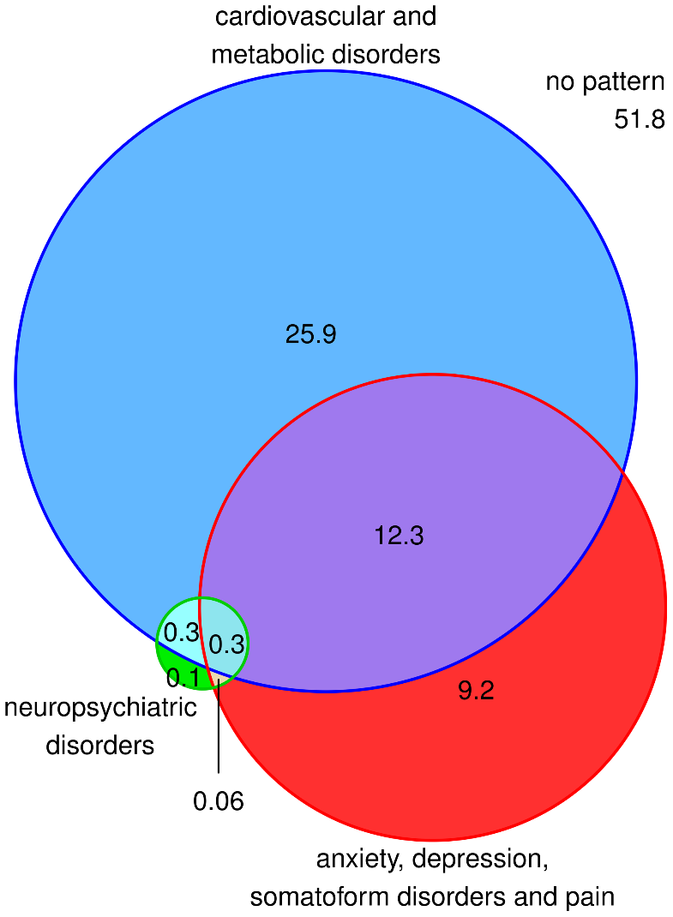
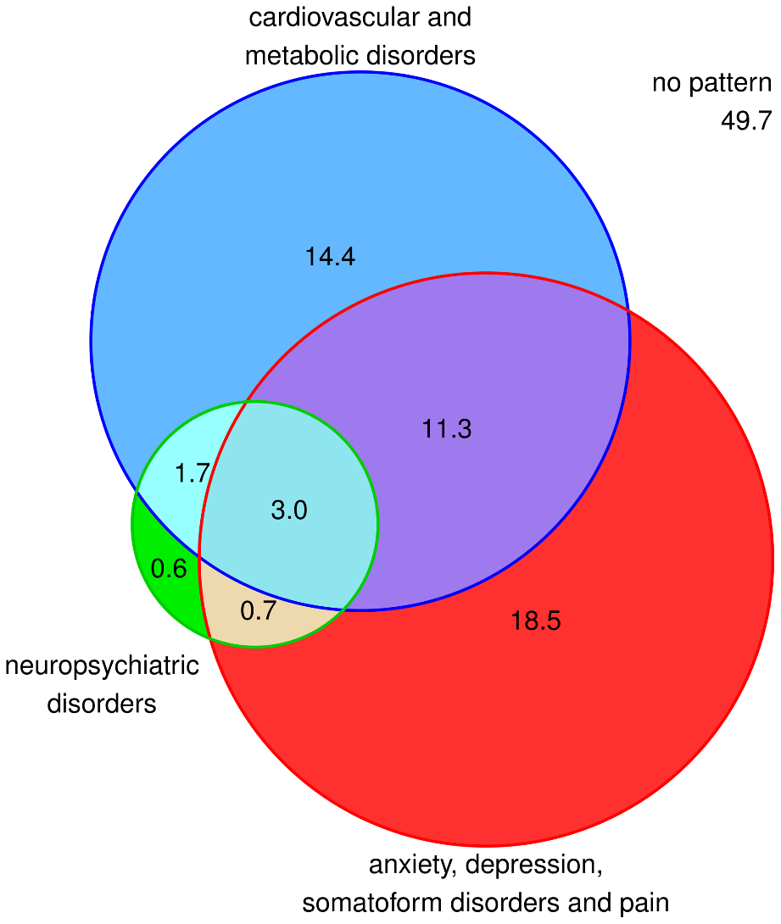
Multimorbidity Clusters: pattern in 65+
Men (% of population)
Women (% of population)
Schӓfer et al: PLOS One 2010

Slide 55
ASMRs by deprivation quintile, 2007
England vs CPRD (linked)
Males (age 25+)
Females (age 25+)

Slide 56
First Cut Data Cleaning Flowchart – Cohort Dataset
Raw cohort data (n=1,258,845)
Remove patients with unknown age, sex, deprivation status (n=4,297)
Step 1 cohort data (n=1,254,548)
Remove visitors (n=346)
Cleaned cohort data (n=1,254,202)
Cohort entering study in 2002
(n=769,583)
Cohort entering study in subsequent years, on turning age 45
Year: 2003 2004 2005 2006 2007 2008 2009 2010 (Q1)
n≈ 63k 58k 62k 62k 65k 71k 69k 35k
Notes:
Flowchart gives an idea of the scale of the dataset. This is based on first-cut dataset with 10 diseases in-scope:
AF, CHD, diabetes, dementia, depression, COPD, cancer, HF, CKD, stroke/TIA
Step 1
Remove patients who fail CPRD data quality standards (n=0)
Remove patients who fail inclusion criteria for this study (n=0)
Step 2
Remove patients with date of entry and date of exit both before study period, or after study period (n=0)
Visitors – patients who had only one consultation with the practice

Slide 57
Prevalence rates across ages – Coronary Heart Disease
CPRD rates are very similar to HSfE rates across sex and age
Source: Health Survey for England 2006: Cardiovascular Disease and Risk Factors

Slide 58
Incidence rates across ages – Heart Failure
Johanssen et al CPRD rates may be slightly higher than our CPRD rates, as the CPRD data referenced is for all UK
However, the patterns by age and sex are very similar (despite Johannsen’s being 6 years earlier)
Source: Johanssen et al, analysis of UK CPRD data in 1996
Notes:
Johanssen et al. 'Incidence of newly diagnosed heart failure in UK general practice‘. Excluded patients with a diagnosis of heart
failure or cancer before that time and pregnant women.

Slide 59
Prevalence rates across ages – Heart Failure
CPRD rates are very similar to BHF’s analysis of CPRD rates across sex and age
Source: British Heart Foundation (BHF) CHD Statistics, 2010 edition: analysis of CPRD 2009 England data

Slide 60
Incidence rates across ages – Cancer
CPRD rates are broadly similar to, but higher than, ONS Cancer registration rates across sex and age, 2006
Source: ONS Cancer statistics registrations for England, 2006
Notes:
(If prompted to discuss: could be due to delays in registration, patients who die not captured on the register, CPRD definition including suspected cancer)

Slide 61
Prevalence rates across ages – Atrial Fibrillation
CPRD rates are significantly higher than BHF rates across sex and age
We expect them to be more similar, as CPRD is a historic snapshot of CPRD. Is there scope for disease definition differences?
4 year difference between sources – should not see a large drop in prevalence
Source: British Heart Foundation Cardiovascular Disease Statistics 2014 report: analysis of CPRD GOLD 2013 data extract

