Slide 1
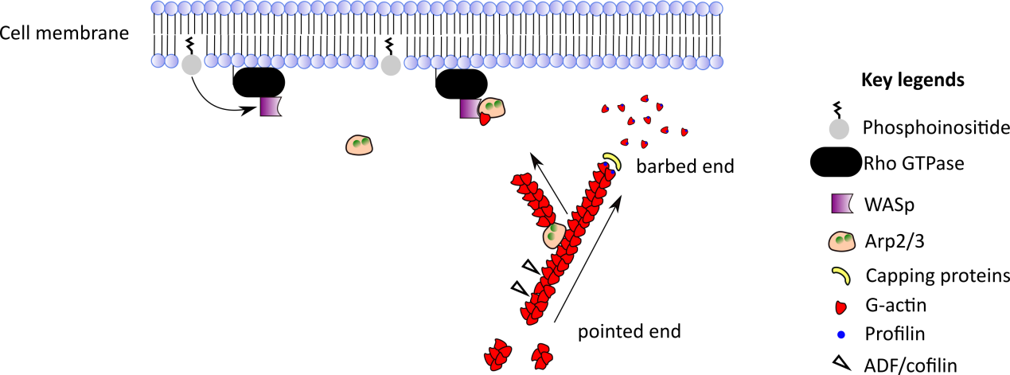
Figure 1

Slide 2
Figure 2
BCR
TCR
Cytokine receptor
Integrin
ERM
Kindlin3
Cor1
MST1
RAC2
WIP
DOCK2
WASp
Cytoskeletal regulators
RAC 2
ARP
CDC
42
DOCK8
CDC
42
MKL1
Nucleus

