Slide 1
Applying framework synthesis in systematic reviews
Ginny Brunton, Sandy Oliver, James Thomas
EPPI-Centre, UCL Institute of Education
g.brunton@ioe.ac.uk
Conflict of Interest statement: None of the authors have any actual or potential conflict of interest in relation to this presentation.

Slide 2
Introduction
Systematic reviews are complex
Multiple interactions exist between intervention components
Interactions between interventions and their contexts
Interactions between intervention effects and mediators or moderators (Petticrew et al. 2013: p.1230)
Framework synthesis might help
It structures disparate ideas on how an intervention might work
Together, these act as a lens to focus our understanding of an intervention.
Context of the work
Innovative use of framework synthesis has been occurring within EPPI-Centre reviews
No previous research syntheses exist examining its use
Part of PhD thesis currently underway with UCL
These are emerging findings!
This seminar
Aims to outline framework synthesis as a method of systematic reviewing, briefly reflecting on its use in three recent EPPI-Centre reviews
Notes:
Systematic reviews of health policy are complex: there are many interactions between and within health interventions, which also interact across the contexts in which they are applied. This makes understanding about ‘what work, for whom and in which contexts’ challenging.

Slide 3
Framework Synthesis
A type of thematic analysis that also involves ‘counting’
Tabular or ‘matrix-based’ method
Construction of thematic categories into which data can be coded (Ritchie & Spencer 1994)
Five steps:
  Familiarisation
  Framework identification
  Indexing
  Charting
  Mapping and Interpretation
Allows themes identified a priori to be specified as coding categories from the start
  Previous theoretical framework (Carroll et al. 2011)
  Researcher experience/background literature (Oliver et al. 2008)
Allows combining with other themes emerging de novo by subjecting the data to inductive analysis (Dixon-Woods 2011)
Notes:
FAMILIARISATION: Overview of a body of material – scoping background literature
IDENTIFY A FRAMEWORK: Abstraction and conceptualisation of background literature, selection/modification of existing theories
INDEXING: Applying the framework to the data (or is it the other way around?)
CHARTING: Rearranging/reordering the data into themes
MAPPING AND INTERPRETATION: Pulling together key characteristics of the data according to the research objectives
WHY CHOOSE THIS METHOD
Transparent
enables questions identified in advance by stakeholders to be explicitly and systematically considered
Flexible
can also detect and characterise issues that emerge from the data
Friendly
a nice blend of aggregating and configuring data (good for researchers new to mixed synthesis methods)

Slide 4
Framework synthesis Systematic review stages
Systematic review processes (Gough et al. 2012)
Review initiation/ Research question formation
Search for potentially relevant research
Inclusion/ exclusion screening
of articles
Data extraction
Synthesis
Interpretation/ communication
Familiarisation
Temporal progression of review
Framework selection
Indexing
Charting
Mapping & interpretation
Stages of Framework synthesis (Ritchie et al. 2014)

Slide 5
Systematic Review of Framework Synthesis Methods
Part I

Slide 6
Review aims and research questions
Aims
To examine the evolving use of framework synthesis in systematic reviews
Research questions:
How do methods of framework synthesis compare across reviews?
Where is framework synthesis located within a range of research synthesis methods?
What problems are addressed specifically by framework synthesis?

Slide 7
Methods
Design: Systematic review using framework synthesis
Framework: Issues based on PhD research question, scoping literature, researcher expertise and previous EPPI-Centre reviews
Search: ASSIA, PsycInfo, PubMed, Web of Science, Key contacts, reference lists of included studies; no date or language limits
Inclusion screening: Studies had to: describe, report, or reflect on the use of ‘framework synthesis’ in systematic reviews of health-related topics
Coding: Framework identified from background searches/research team expertise
Analysis/Synthesis: Descriptive analysis of codes identified through framework, line-by-line thematic analysis of content of data to which each code applied

Slide 8
Initial Framework
Framework synthesis appears to vary according to:
the aims of the reports that use it
how authors describe it (in both methodological and epistemological terms)
whether it is used in a substantive review or placed within a range of research synthesis methods
authors’ assertions of its strengths and limitations
other factors not yet identified
Findings from each code were thematically analysed to discover patterns
Based on:
PhD research questions
issues identified through scoping searches
researcher knowledge of qualitative research methods
standard data extraction tools developed in previous reviews
As per Oliver et al. (2008)
Notes:
In this review, no existing conceptual framework of framework synthesis in systematic reviewing was located.
Thus it was decided to begin by using the research questions posed in the PhD proposal to develop the conceptual framework: in effect, to investigate how framework synthesis has been described, applied and conceptualised in systematic reviews and related methodology literature.
These research questions were themselves derived from discussion papers identified in the scoping searches undertaken for writing the PhD proposal, from the researcher’s knowledge of qualitative research methods, and from standard data extraction tools developed over several years of systematic reviewing at the EPPI-Centre.
These sources of knowledge about framework synthesis indicated that the method could vary according to:
-the aims of the reviews and reports that use it;
-how authors of reports describe it (both in methodological and epistemological terms);
-whether it is used in a substantive review report or placed within a range of synthesis methods;
-authors’ perceptions of its strengths and limitations.

Slide 9
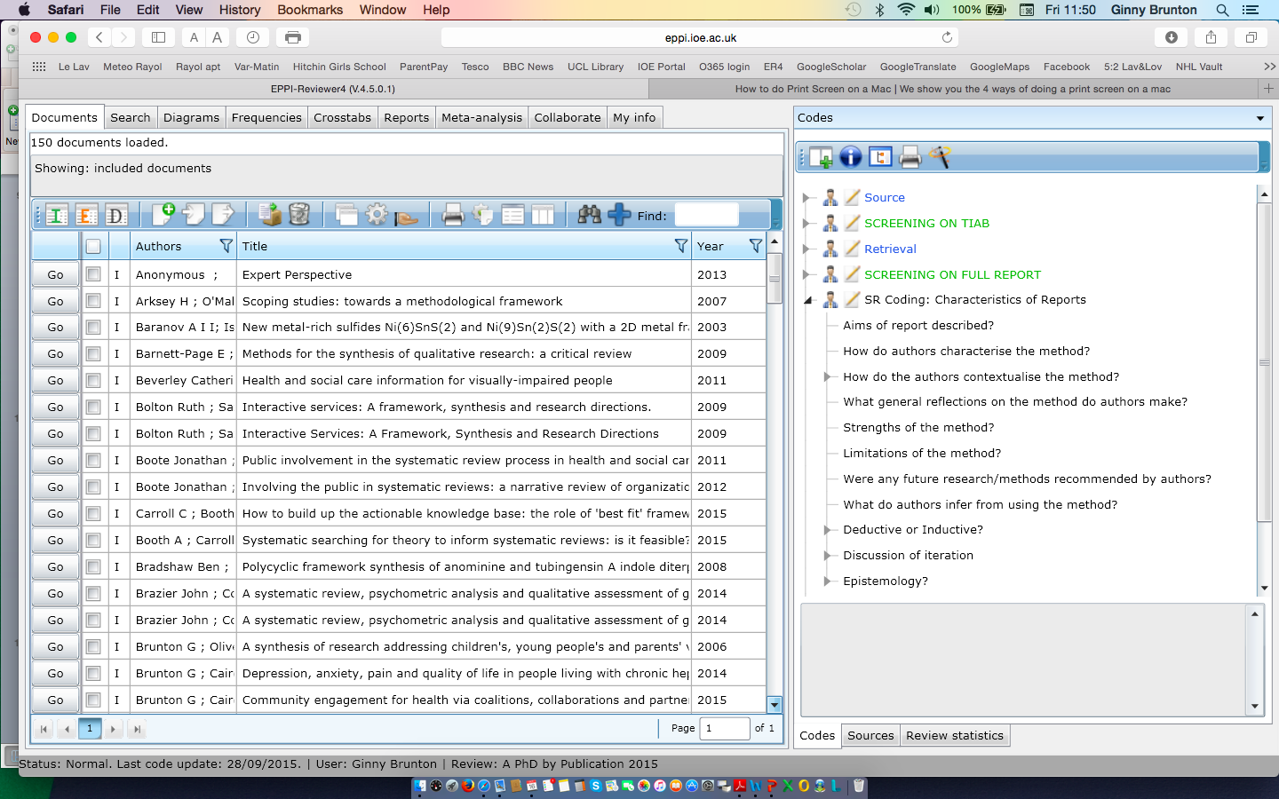

Slide 10
Framework

Slide 11
Results: Flow of studies through review
145 located references
Screening on title/abstract
55 potentially relevant references
90 excluded on basis of title/abstract:
-55 not about framework synthesis
-1 not about health care/policy/public health
-34 duplicate references
Screening on full report
15 included reports
40 excluded on basis of full report:
-20 not about framework synthesis
-20 not about methods
Data extraction / Synthesis

Slide 12
Results: Flow of studies through review
145 located references
Screening on title/abstract
55 potentially relevant references
90 excluded on basis of title/abstract:
-55 not about framework synthesis
-1 not about health care/policy/public health
-34 duplicate references
Screening on full report
15 included reports
40 excluded on basis of full report:
-20 not about framework synthesis
-20 not about methods
Data extraction / Synthesis

Slide 13
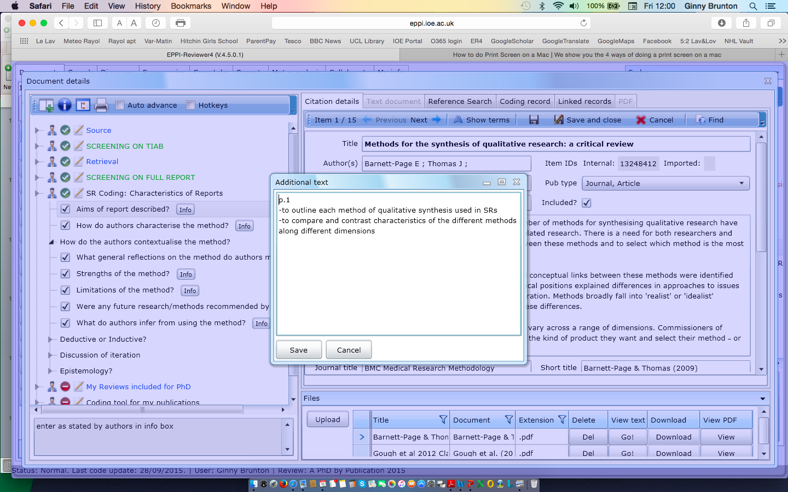
Data Extraction

Slide 14
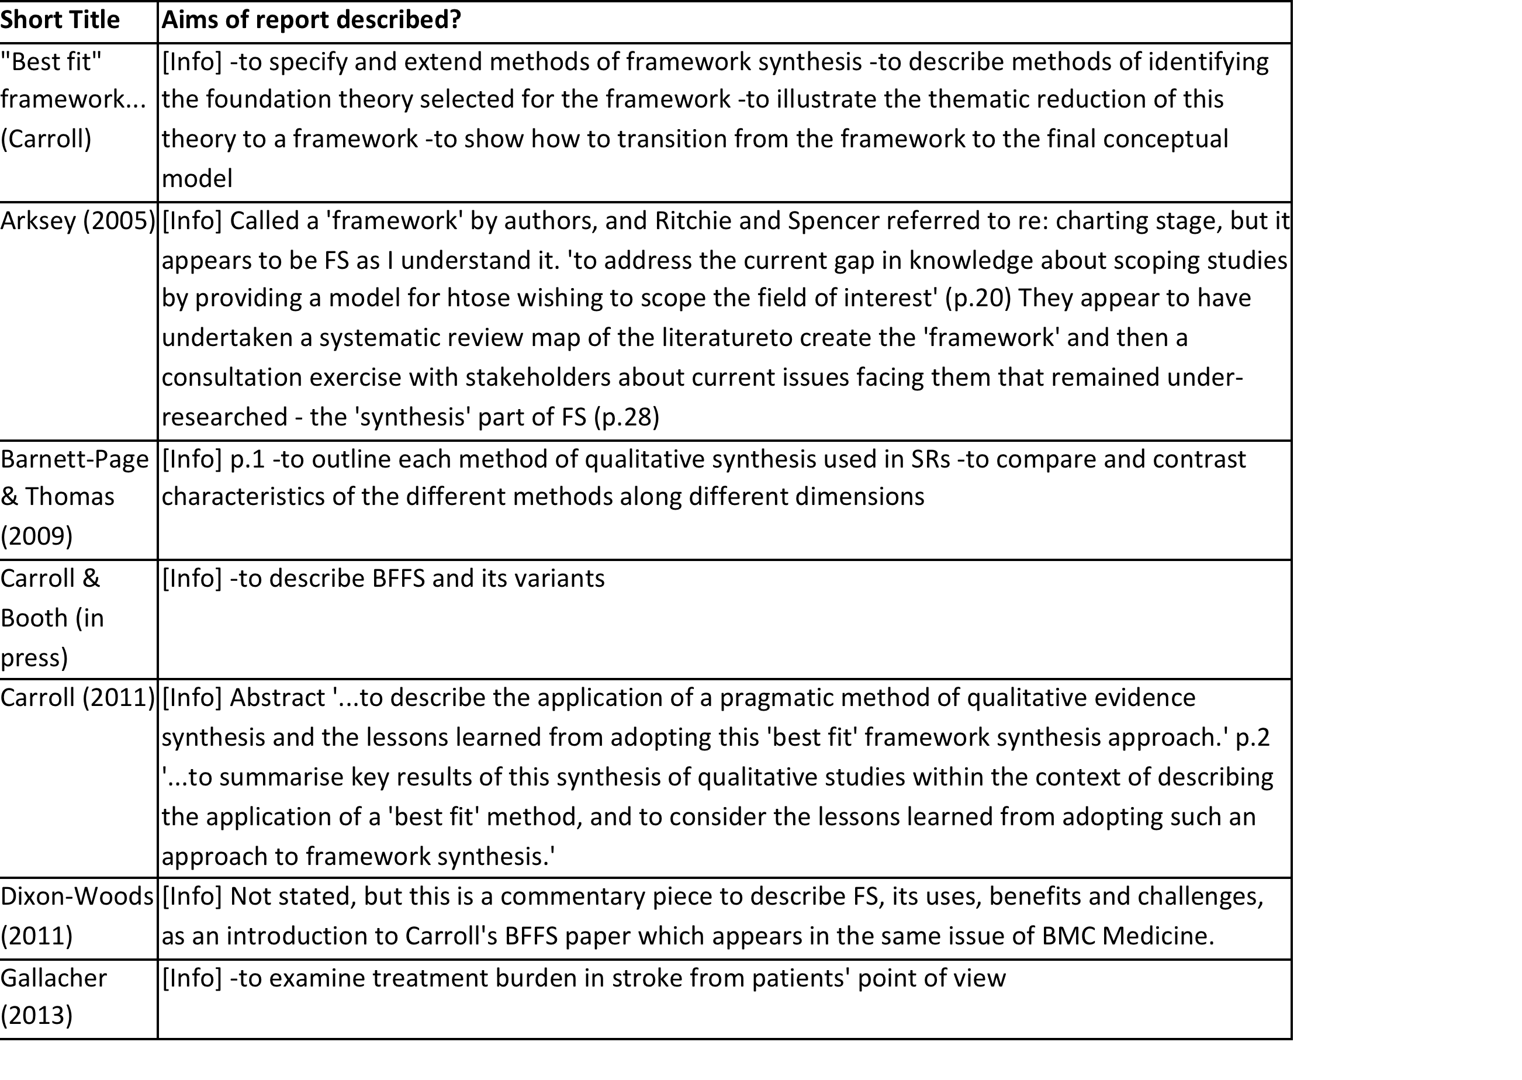
Thematic analysis

Slide 15
Thematic analysis

Slide 16
Thematic analysis
illustrative
situated
illustrative
illustrative
applied

Slide 17
Results
…Use of framework synthesis
n=7 ‘applied’
n=3 ‘illustrated’
n=5 ‘situated’
…Dimensions
Stakeholder views
Study diversity
Quality assessment
Theoretical stance and dynamic qualities
Notes:
Stakeholder views
Practical, transparent way to embed diverse views
Potential for further use in public engagement in design, delivery and evaluation
Study diversity
Handles heterogeneity
-Type of data (numeric, textual)
-Combining different foci (different situations, mixed methods synthesis)
Quality assessment
No common method used
Mirrors broader qualitative synthesis discussions
Theoretical stance/ dynamic qualities
Neither theoretical/reviewer stance nor the context within which review takes place clearly described
Critical -> interpretive realism
More useful for addressing causality than mid-range theory
Less useful when concepts are clearly defined and little ‘contextualising’ is needed
Varying degrees of exploration and interpretation, depending on context of review and research questions
Not static – the conceptual framework can evolve as the population under study evolves
Strengths of the review
First attempt to synthesise the research literature about framework synthesis
Selection and development of initial conceptual framework allowed transparent structured critical analysis of diverse data
This addresses some calls for clearer description of interpretation methods (Dixon-Woods et al. 2005; Sandelowski et al. 2012; Tong et al. 2011)
Limitations of the review
Some papers may have been missed that undertook FS but did not identify it as such
Using framework synthesis to examine framework synthesis…overcomplicated?

Slide 18
Discussion
Stakeholder views
Practical, transparent way to embed diverse views
‘Two stage’ reviews rarely used
Potential for further use in public engagement in design, delivery and evaluation
Study diversity
Handles heterogeneity
  Type of data (numeric, textual)
  Combining different foci (different situations, mixed methods synthesis)
Quality assessment
No common method used
Mirrors broader qualitative synthesis discussions
Theoretical stance/ dynamic qualities
Rarely clearly described
Scientific -> critical realism
More useful for addressing causality rather than addressing middle-range theory
Less useful when concepts are clearly defined and little ‘contextualising’ is needed
Varying degrees of exploration and interpretation, depending on context of review and research questions
Not static – the conceptual framework can evolve as the population under study evolves

Slide 19
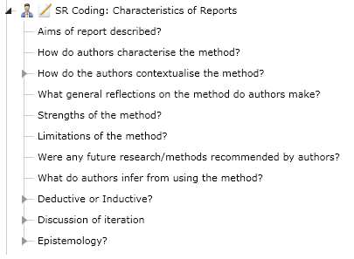
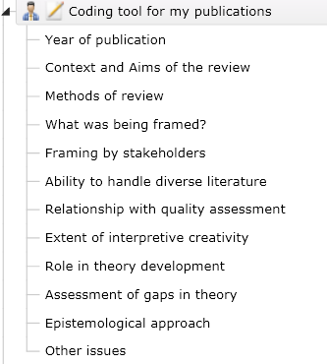
A new conceptual framework
Initial framework
New conceptual framework

Slide 20
Discussion
Strengths
First attempt to synthesise the literature
Selection and development of initial conceptual framework allowed transparent structured critical analysis of diverse data
Could address need for clearer description of interpretation methods (Dixon-Woods et al. 2005; Sandelowski et al. 2012; Tong et al. 2011)
Limitations
Some papers may have been missed that undertook FS but did not identify it as such
Using framework synthesis to examine framework synthesis…overcomplicated?
Notes:
Strengths
First attempt to synthesise the research literature about framework synthesis
Selection and development of initial conceptual framework allowed transparent structured critical analysis of diverse data
This addresses some calls for clearer description of interpretation methods (Dixon-Woods et al. 2005; Sandelowski et al. 2012; Tong et al. 2011)
Framework synthesis…
…is deductive
a priori framework, iterative coding
…but is also inductive
thematic development as meaning of codes are combined
…can be placed between critical and scientific realism
Practical use in engaging stakeholders

Slide 21
Answering the research questions
How do methods of framework synthesis compare?
What problems are addressed by framework synthesis and not by other methods?
Used in complex reviews
Framework synthesis shares characteristics of both aggregative and configurative synthesis
The iterative and interpretive nature of thematic development also allows new insights to develop
Methods vary
  how and when a previously existing conceptual framework is identified
  the extent of iteration and inductive testing that occurs relative to each review’s aims and research questions
  Context and stance needed
Can help make reporting of methods more transparent
A method of combining data that allows both aggregation and configuration of findings fit to purpose and context of the review
‘Selective eclecticism’ approach could address calls for paradigm shift in synthesis methods

Slide 22
How do methods of framework synthesis compare within previous literature?
Framework synthesis shares characteristics of both aggregative and configurative synthesis
The iterative and interpretive nature of thematic development also allows new insights develop
Methods vary
  how and when a previously existing conceptual framework is identified
  the extent of iteration and inductive testing that occurs
    relative to each review’s aims and research questions
Notes:
Framework synthesis is useful because it can help make reporting of methods more transparent: readers can see clearly the original conceptual framework, the themes that are derived from the data populating that framework, and how the themes are translated back into the original framework to further develop that theory. This makes its methods of synthesis more explicit than other methods. This lack of reporting clear methods of synthesis has been flagged as a challenge in qualitative research synthesis (Tong et al. 2012).

Slide 23
What problems are addressed by framework synthesis and not by other methods?
  Can help make reporting of methods more transparent
  A method of combining data that allows both aggregation and configuration of findings fit to purpose and context of the review
  ‘Selective eclecticism’ approach could address calls for paradigm shift in quantitative and qualitative synthesis methods

Slide 24
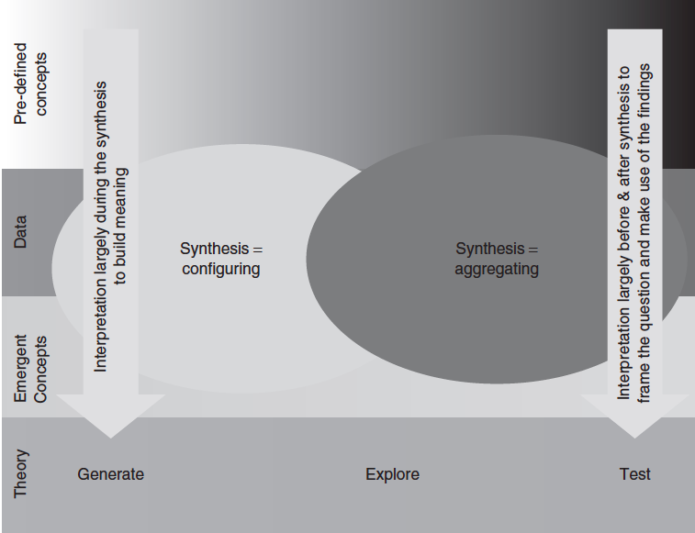
Where is framework synthesis located within the context of a range of research synthesis methods?
Meta-Analysis
Framework Synthesis
Critical Interpretive Synthesis
(from Thomas et al. 2012:181)
Notes:
2. Where is framework synthesis located within the context of a range of research synthesis methods?
a realist method that is positioned ‘in the middle’ in terms of its deductive and inductive reasoning and iteration to build and test theory using heterogeneous data
allows enough interpretive creativity for it to move between critical realism and scientific realism
findings from some reports suggest that this may be dependent on the extent to which stakeholders views are employed either as participants in the research process or as the phenomenon under study

Slide 25
Conclusions
Framework synthesis has been used previously to examine complex health care issues
Methods of selecting and using a framework in stakeholder engagement decision-making are developing
Philosophical stance of a study should fit the research question, which is derived from the context and from researcher preferences
Notes:
The results of this review suggest that, as echoed by others, the philosophical stance of a study should fit the research question, which itself is derived from both the context in which the phenomenon under study is occurring and from the researcher’s own preferences (Gough et al. 2012; Green & Thorogood 2014). Further, clearly communicating these will help readers to understand and interpret the review’s methods and findings and determine whether they are applicable to their own situations.
The findings from this review have provided a conceptual framework of the dimensions of framework synthesis. This will operate as the initial structure for examining the publications in which I have applied framework synthesis.

Slide 26
Examining EPPI-Centre reviews’ use of framework synthesis
Part II

Slide 27
Examining recent EPPI-Centre FS reviews:
Method
Research Questions
How do methods of framework synthesis compare across reviews?
Where is framework synthesis located within a range of research synthesis methods?
What problems are addressed specifically by framework synthesis?
Dataset: Three systematic reviews
Walking and cycling
Extrahepatic conditions in hepatitis C
Community engagement
Familiarisation
Systematic review (!)
Conceptual framework
Developed in systematic review
Indexing
Applied framework (as a data extraction tool) to each review
Charting
Thematic analysis undertaken across all three reviews
Mapping & interpretation
Relating themes back to research questions, Part I systematic review and to wider methods literature

Slide 28
Examining recent EPPI-Centre FS reviews:
Method
Research Questions
How do methods of framework synthesis compare across reviews?
Where is framework synthesis located within a range of research synthesis methods?
What problems are addressed specifically by framework synthesis?
Dataset: Three systematic reviews
Walking and cycling
Extrahepatic conditions in hepatitis C
Community engagement
✔
Familiarisation
Systematic review (!)
Conceptual framework
Developed in systematic review
Indexing
Applied framework (as a data extraction tool) to each review
Charting
Thematic analysis undertaken across all three reviews
Mapping & interpretation
Relating themes back to research questions, Part I systematic review and to wider methods literature
✔
✔

Slide 29
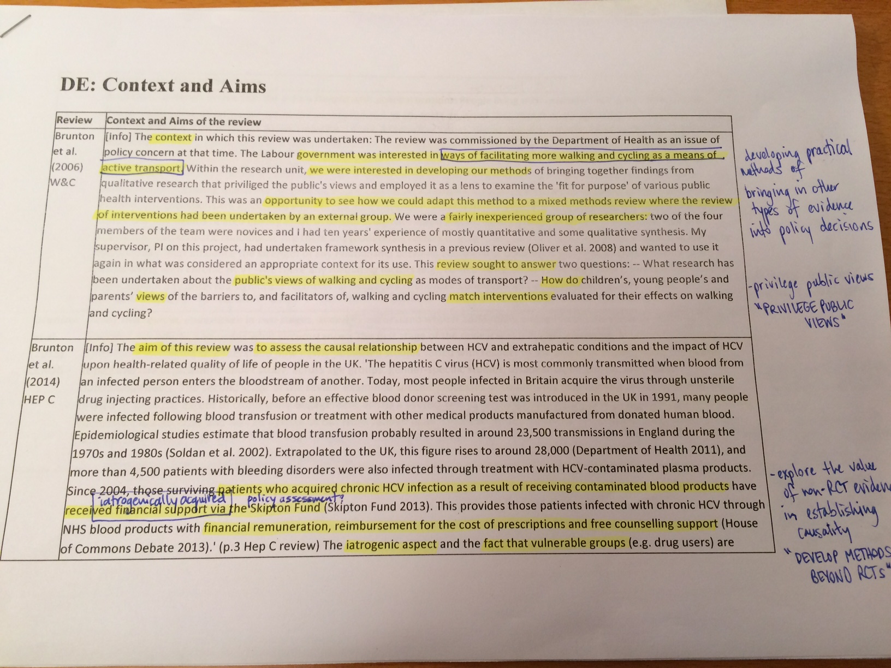
Example: Context/Aims

Slide 30
Thank you!
Further questions/discussion

