Slide 1
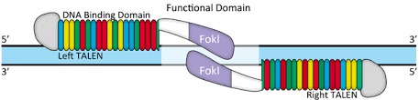

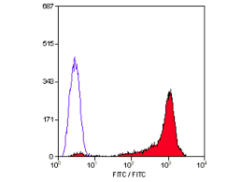
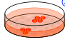




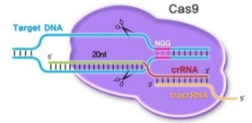
A
No protein expression
exon
Ex 1-13polyA
1
2
3
13
2
3
13
intron 1
Gp91phox
CYBB Ex 1-13 poly A
myeloid differentiation
Cas9
Targeted gene insertion into iPSCs
B
C
C
Protein expression
exon
Ex2-13polyA
1
2
3
13
1
3
13
intron 1
intron 1
Gp91phox
CYBB Ex 2-13 polyA
myeloid differentiation
Targeted gene insertion into iPSCs

