Slide 1
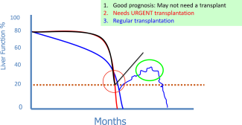
Novel approaches and therapeutics in acute‐on‐chronic liver failure
Liver Transplantation
Volume 22, Issue S1, pages 14-19, 26 OCT 2016 DOI: 10.1002/lt.24621
http://onlinelibrary.wiley.com/doi/10.1002/lt.24621/full#lt24621-fig-0004
Notes:
A picture depicting potential outcomes of patients with ACLF and the possible timings of liver transplantation.
IF THIS IMAGE HAS BEEN PROVIDED BY OR IS OWNED BY A THIRD PARTY, AS INDICATED IN THE CAPTION LINE, THEN FURTHER PERMISSION MAY BE NEEDED BEFORE ANY FURTHER USE. PLEASE CONTACT WILEY'S PERMISSIONS DEPARTMENT ON PERMISSIONS@WILEY.COM OR USE THE RIGHTSLINK SERVICE BY CLICKING ON THE 'REQUEST PERMISSIONS' LINK ACCOMPANYING THIS ARTICLE. WILEY OR AUTHOR OWNED IMAGES MAY BE USED FOR NON-COMMERCIAL PURPOSES, SUBJECT TO PROPER CITATION OF THE ARTICLE, AUTHOR, AND PUBLISHER.

