Slide 1
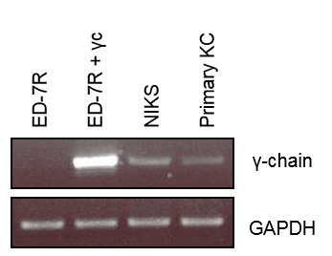
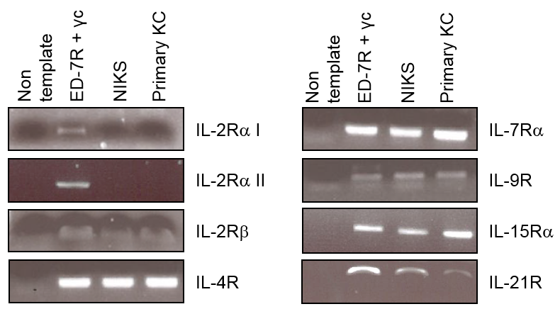
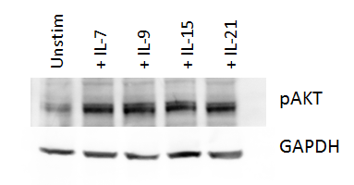
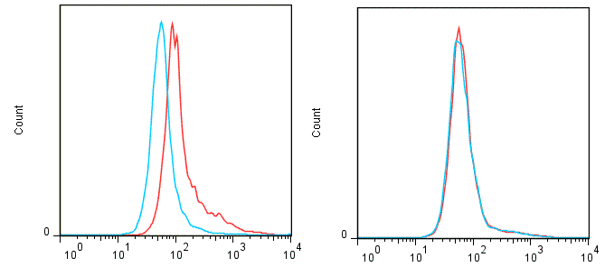
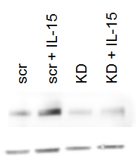
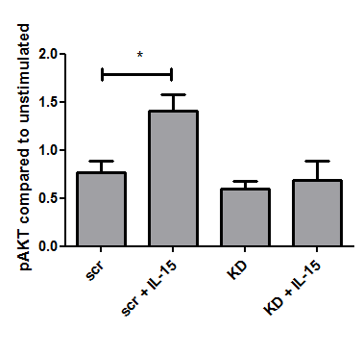
Fig. 1
a)
b)
c)
d)
scr KD
Isotype
γ-chain
pAKT
GAPDH

Slide 2
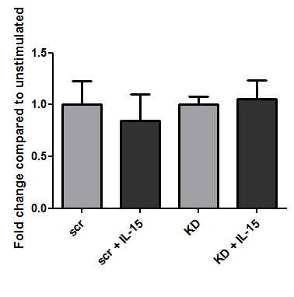
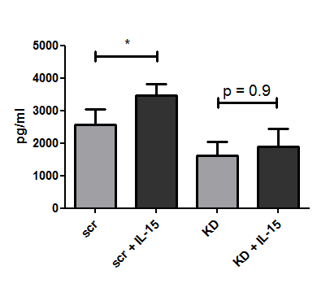
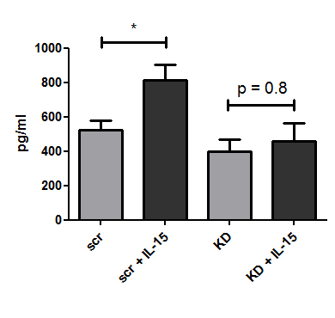
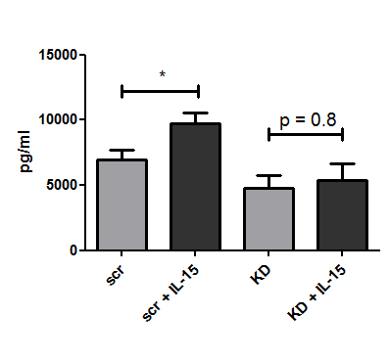
Fig. 2
a) RANTES b) IL-8
c) Mip-3α d) Gro-α

Slide 3
Fig. 3
a) b)
c) d)

Slide 4
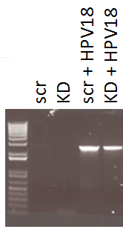
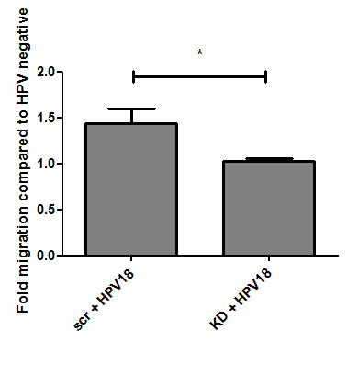
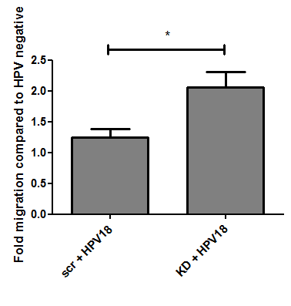
Fig. 4
a) b)
c)

Slide 5
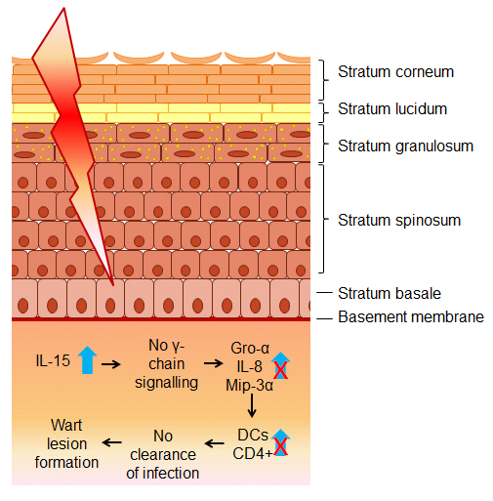
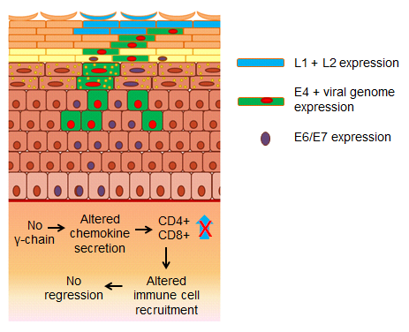
Fig. 5
Early stages of infection
Late stages of infection

Slide 6
Supplements

Slide 7
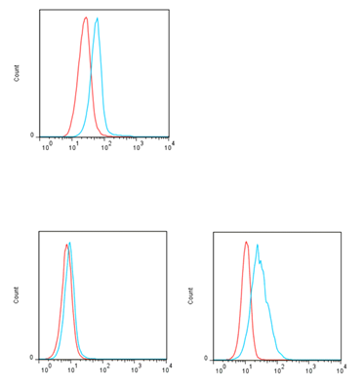
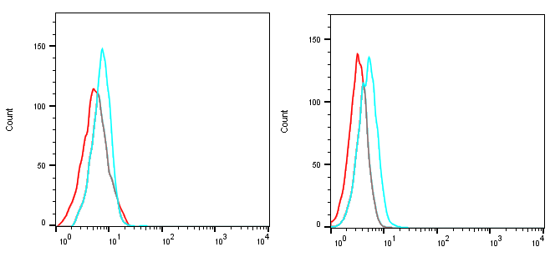
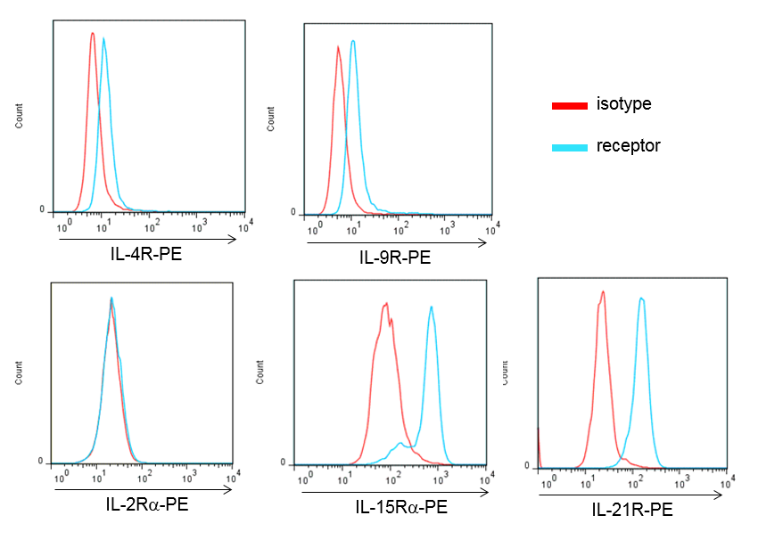
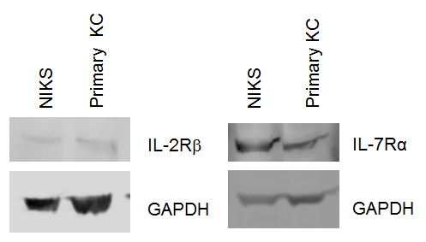
Fig, S1
a)
b)
c)
Primary keratinocytes NIKS CD8+ T cells
ED-7R ED-7R + γc
isotype control
γ-chain
γ-chain-APC

Slide 8
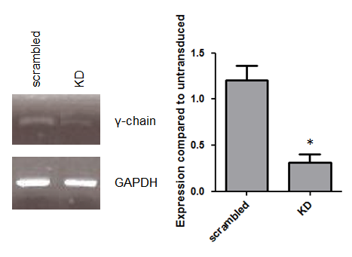
Fig. S2
a)
b)

Slide 9
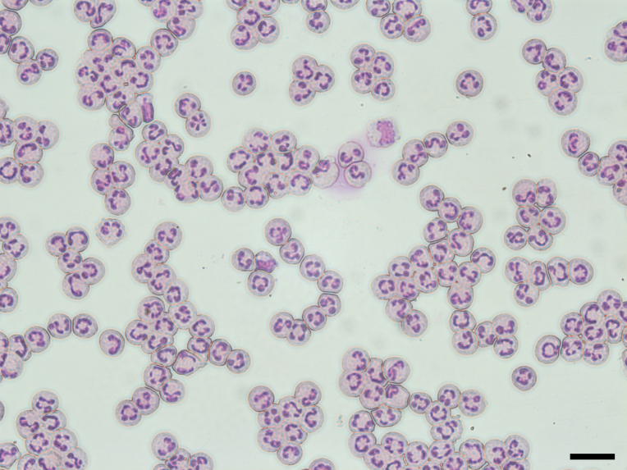
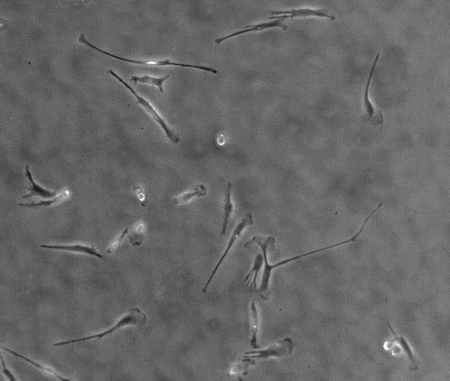
Fig. S3
a)
b)
c) d)

Slide 10
Fig. S4
a)
b) c)

Slide 11
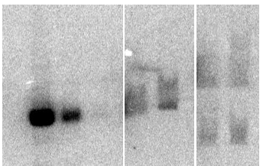
100 copies
10 copies
1 copy
scr + NcoI + DpnI
KD + NcoI + DpnI
scr + HindIII + DpnI
KD + HindIII + DpnI
Fig. S5
open circular
linear
supercoiled

