Slide 1
Subway Station Real-time Indoor Positioning System for Cell Phones
Chengqi Ma¹
Chenyang Wan¹; Yuen Wun Chau¹; Soong Moon Kang²; David R. Selviah¹;
¹Department of Electronic & Electrical Engineering
²School of Management
University College London, UCL

Slide 2

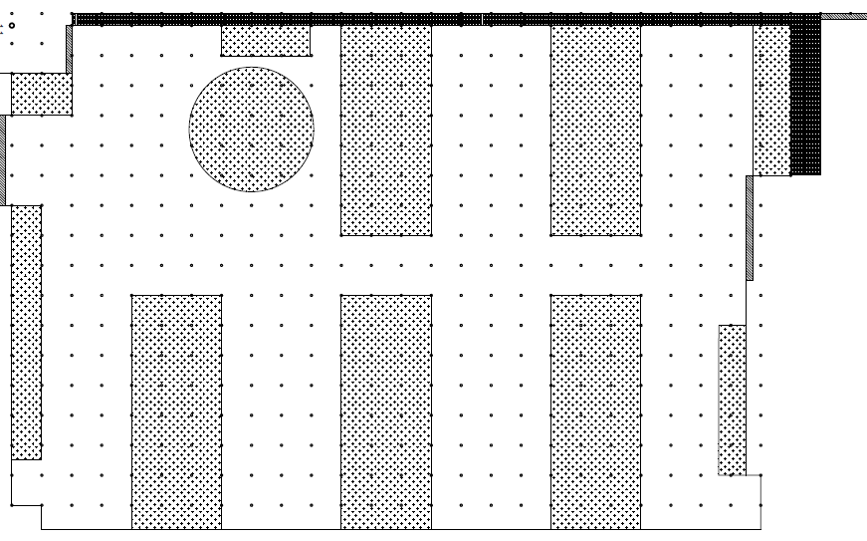
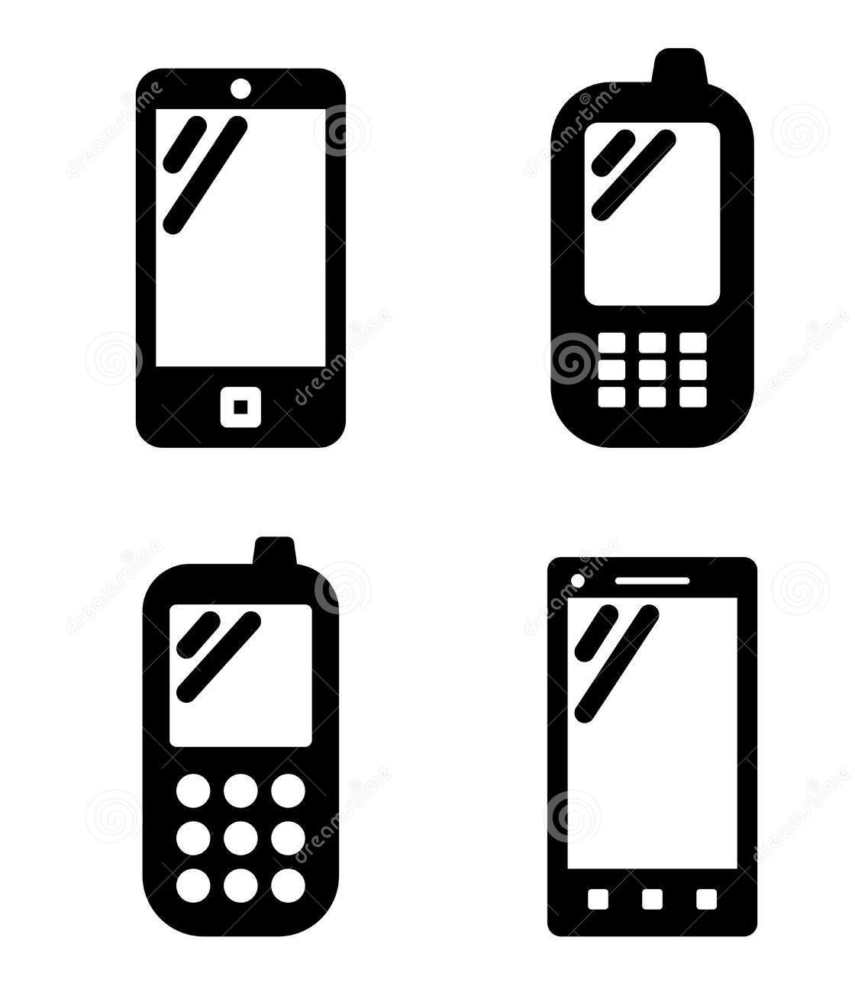

Introduction
Functions
Server
Server side: Tracking users’ cell phones. Collect data for study of users’ trajectories and monitoring congestion.
Client side: Navigation services in GPS-denied environments.
Clients(real time)

Slide 3
Introduction
Localization Technologies:
A radio ‘fingerprint’ is the pattern of radio signal strength measurements that is observed at a given location.
It comprises a vector of signal identity information (e.g. Wi-Fi MAC addresses, or cellular Cell-IDs) and a corresponding vector of values of Received Signal Strength (RSS).
Wi-Fi Fingerprinting
Pedestrian Dead-Reckoning (PDR)
Signal processing Technology:
Kalman Filter

Slide 4
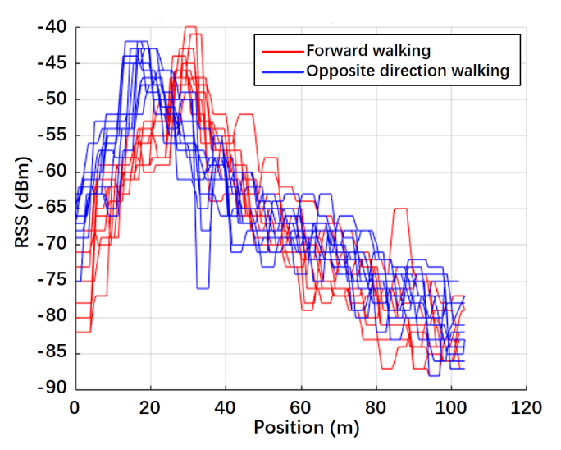
Problems and Challenges
≈14m
1) Body block effect
This is an example of the RSS distribution on a straight platform received from one AP when the device holder walks back and forth ten times.

Slide 5
Problems and Challenges
2) Environmental variation effect
Unstable signal strength
Wi-Fi signal (space/time)
Sensor data from cellphone
Environment variation
Periodically arriving and departing metallic trains
Group of people during different time periods

Slide 6
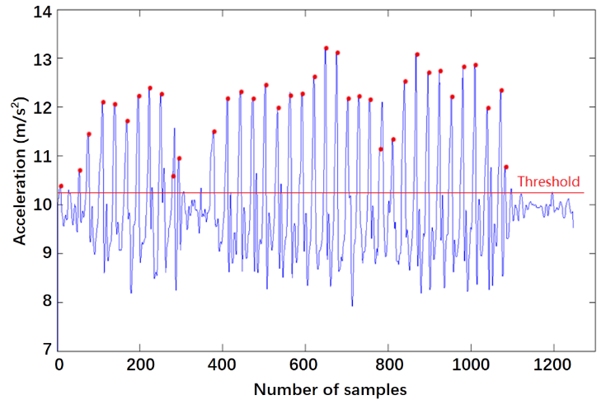
Database Establishment
1) Pedestrian Dead-reckoning (PDR) mapping support
Testing set number | 1 | 2 | 3
Actual steps | 100 | 100 | 100
Average measured steps | 97 | 98 | 103
Null steps | 3 | 2 | 4
Average accumulated error | 1.89 metres | 1.26 metres | 1.89 metres
Overall accuracy | 97.3%

Slide 7
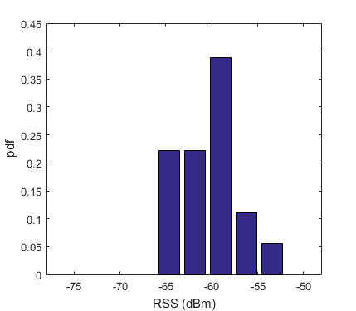
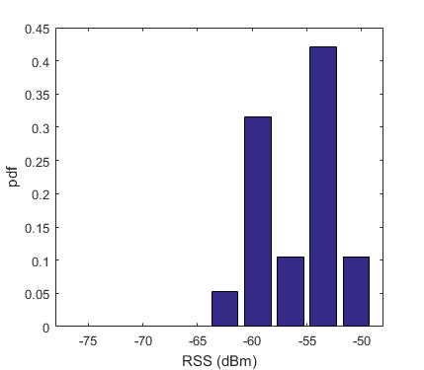
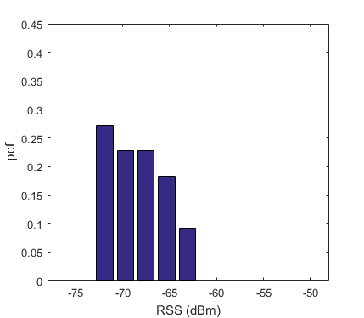
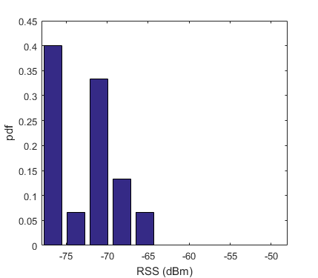
Database Establishment
2) Unique RSS distributions probability density function (PDF) fingerprint
3) Extra information
Probability of occurrence R
Direction coefficient D
RSS histogram distributions from one AP at different reference points.

Slide 8
Database Establishment
4) Database Scale
Around 40 APs can be detected at one reference point
2382 reference points in two stations.
1104 detectable APs
Data collecting work through a whole month

Slide 9

Online Matching Phase

Slide 10
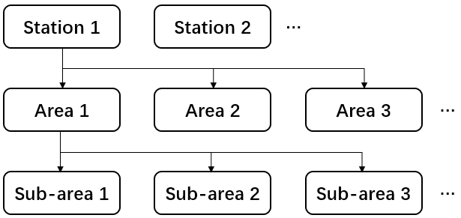
Online Matching Phase
1) MAC address matching

Slide 11
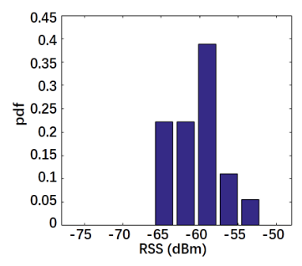
Online Matching Phase
2) Feature Matching
Pr
is a single tracking data RSS detected from one AP
is the feature distribution of the AP at one reference point

Slide 12
Online Matching Phase
3) Probability Mark Selection
For each selected reference point, we define and calculate a Mark to evaluate the matching probability
k-nearest neighbours selection function

Slide 13
Online Matching Phase
4) Discrete Kalman Filter
The Kalman filter is a widely used signal processing technique for trajectory optimization. It is a two-step algorithm for linear systems to help improve the estimation of their next states. Based on a given system’s current state and a dynamic model of the target trajectory, it initially predicts the next state of the system. The next step combines the predicted value with the actual value, giving rise to a more accurate estimate of the next state.
Trajectory smoothing
Matching failed point prediction

Slide 14
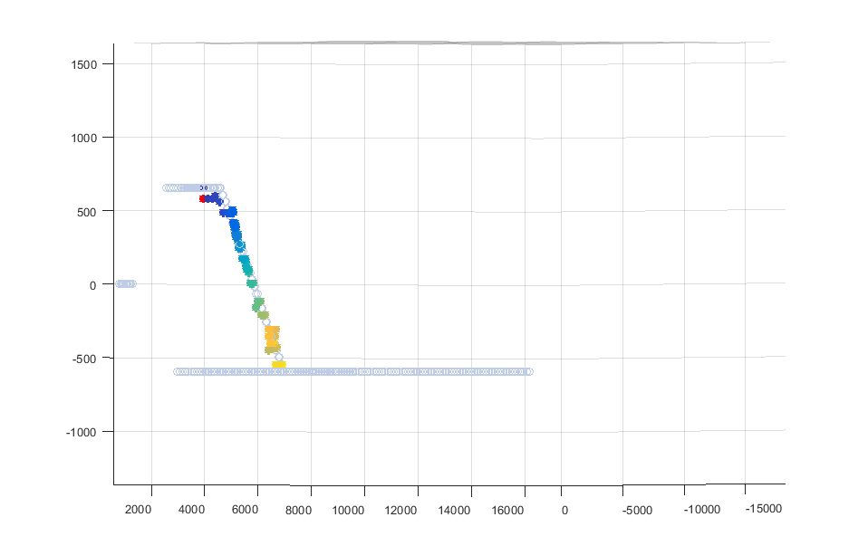
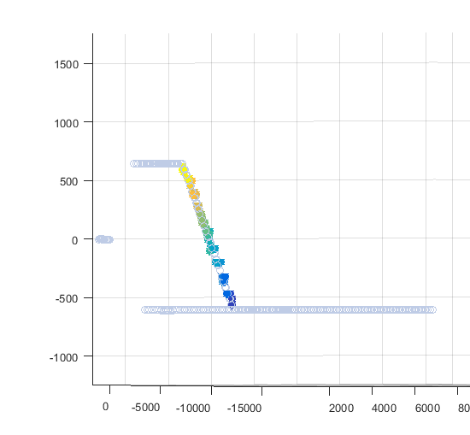
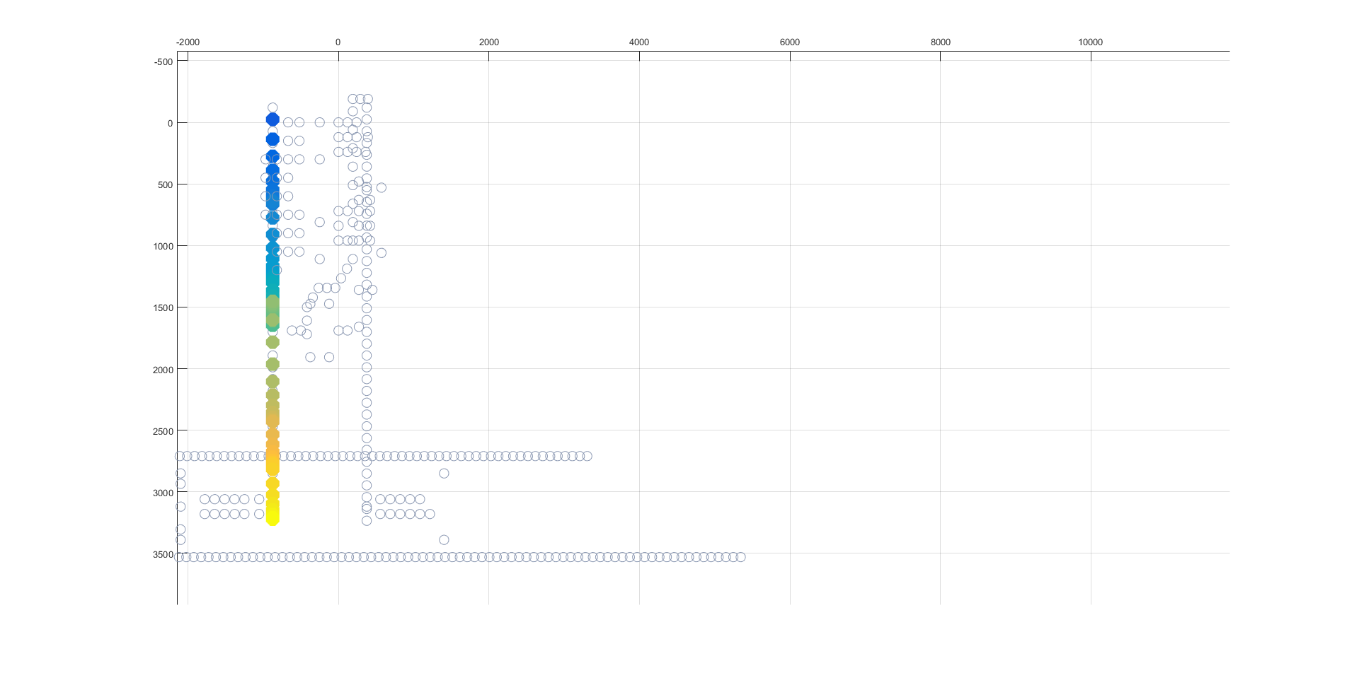
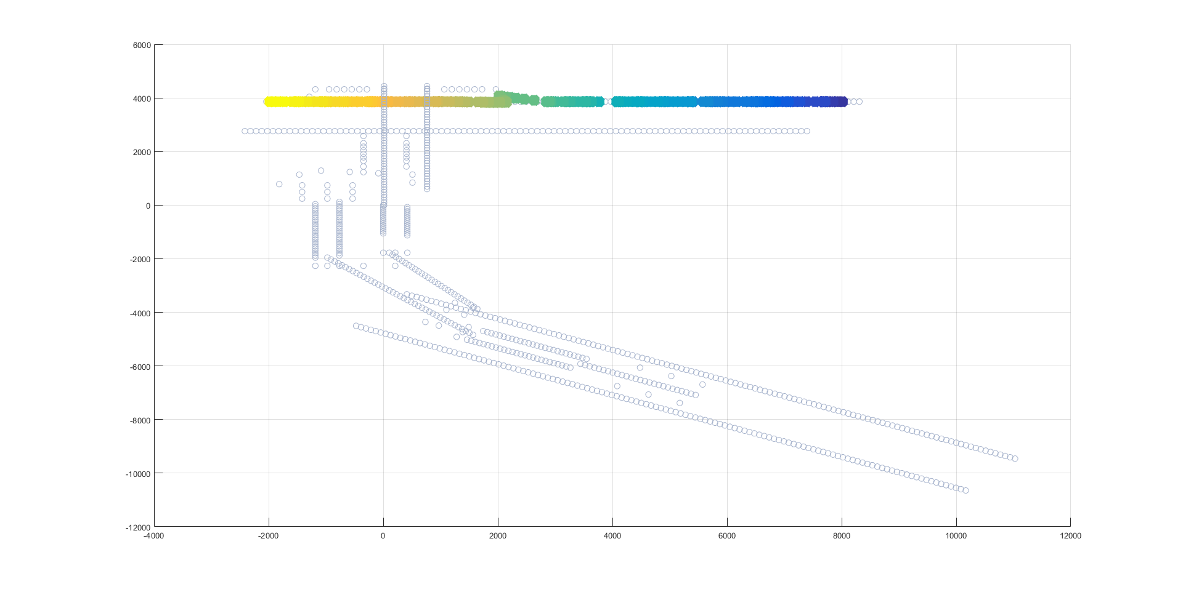
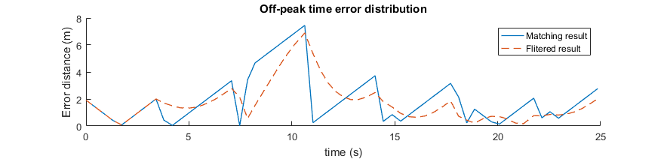
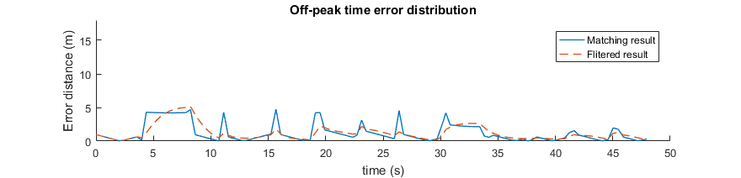
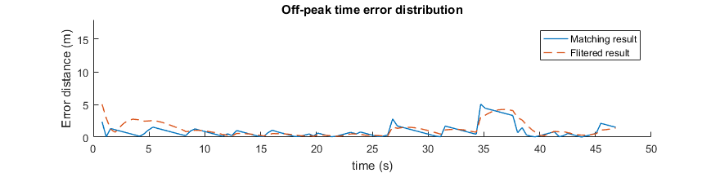
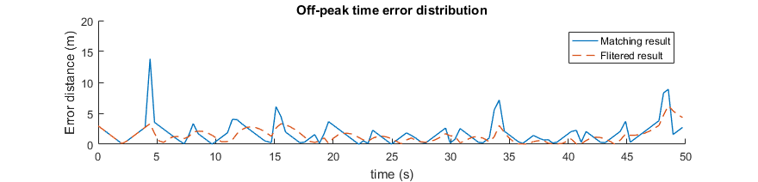
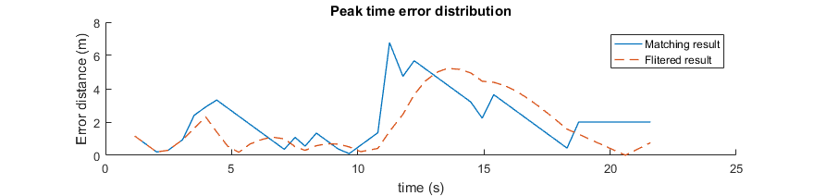
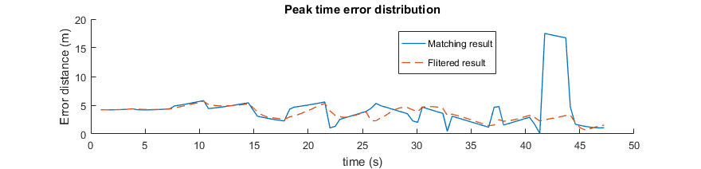
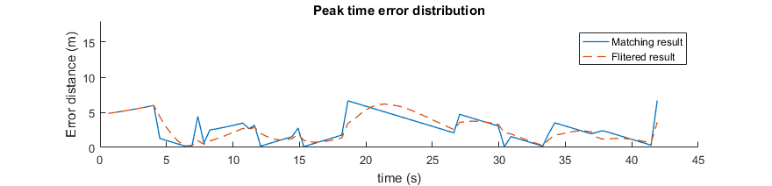
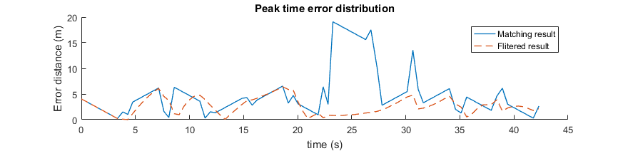
System performance in separated areas
Experiment area | Off- peak time |  | Peak time
 | Matching result | Filtered result | Matching result | Filtered result
Platform | 1.97 m | 1.50 m | 4.91 m | 2.62 m
Tunnel | 1.92 m | 1.72 m | 2.15 m | 1.79 m
Escalator up | 1.23 m | 1.23 m | 4.23 m | 3.55 m
Escalator down | 0.91 m | 1.18 m | 2.73 m | 2.66 m

Slide 15
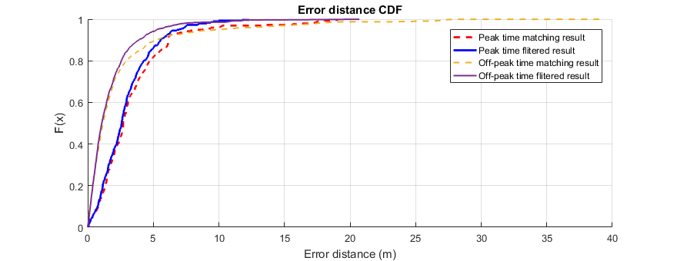
System performance overall
System performance | Off- peak time |  | Peak time
 | Matching result | Filtered result | Matching result | Filtered result
Overall average error distance | 2.37 m | 1.71 m | 3.42 m | 2.90 m
80% CDF error distance | < 2.91 m | < 2.54 m | <4.77 m | <4.2 m

Slide 16
Acknowledgements
The authors wish to thank the subway station operators for allowing us to carry out the experiments reported in this paper
Thank to my supervisor Dr David Selviah. Also thank to Dr Soong Moon Kang to provide this research opportunity.
Thank you all for listening !

